Slide 1
EAR Watch Communication
Creating meaningful messaging for stakeholders

Slide 2
Key reminders for stakeholders
Rainfall status is ’looking back’, rainfall outlook is ‘looking forward’
Released every month
Outlook is for the coming three-month (sometimes six-month) period
An early ‘heads up’ of general drier than normal or wetter than normal conditions over a multi-month time period, giving you time to prepare
NOT how much wetter or drier than normal for the coming months
NOT how extreme rainfall may be in any one event
NOT how rainfall may vary within the three month period
X NOT a replacement for weather forecasts

Slide 3
Some common questions from stakeholders…
“Will we get a drought?”
“How long will this drought last?”
“When will the drought end?”
We don’t yet have an objective method of forecasting drought but we can use the monitoring and outlooks to make an educated guess

Slide 4
Combining the monitoring and outlook statements
If we know the current status and the outlook can we make a subjective forecast about the categorial status?
Rainfall Status + Rainfall Outlook = Future Rainfall Status?
You could, but we need to be careful. Use educated best-guess approach until a more objective method becomes available. Example -
Drought at the 3-month timescale
Outlook for the next 3-months is Alert 3 Dry
Is the categorical status for the next 3 months likely to be drought?

Slide 5
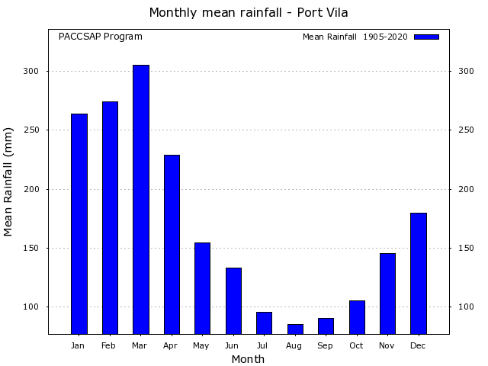
Combining the monitoring and outlook statements
What else do we need to know: ENSO status and forecast, climatology, drought trend/forecast etc.
Impact of water deficiency more (less) likely going into the dry (wet) season
More likely to have issues with excessive rainfall going into the wet season
Take the time to review the 'need to knows'. If your percentile value is 38% and your percentile values are increasing, there is less certainly around future drought status even with Alert 2 or 3 dry COMPARED with being at 10%, approaching the peak or at the peak of the event with an Alert 2 or 3 dry outlook

Slide 7
All islands in Tokelau are experiencing meteorological drought. (from the rainfall status)
Drought is likely to continue for the coming months. (from the rainfall outlook, alert 3 dry)
Continued impacts on household and community water tanks, shallow and deeper rooted crops and small trees are likely. (from the environmental impacts table)
Q: What other factors should we take into account in creating this summary statement?

Slide 8
The ‘cheat sheet’
Rainfall Status
Drought | Drought likely to continue | Drought likely to continue | Drought likely to continue |  |  |  | Drought may begin to ease | Drought may begin to ease
Drought warning | Likely to proceed to drought | Likely to proceed to drought
Drought watch | May proceed to drought | May proceed to drought
Not available
No alert
Very wet | Very wet conditions may ease | Very wet conditions may ease |  |  |  | Very wet conditions likely to continue | Very wet conditions likely to continue | Very wet conditions likely to continue
Outlook | Alert 3 dry | Alert 2 dry | Alert 1 dry | Not available | No alert | Alert 1 wet | Alert 2 wet | Alert 3 wet

Slide 9
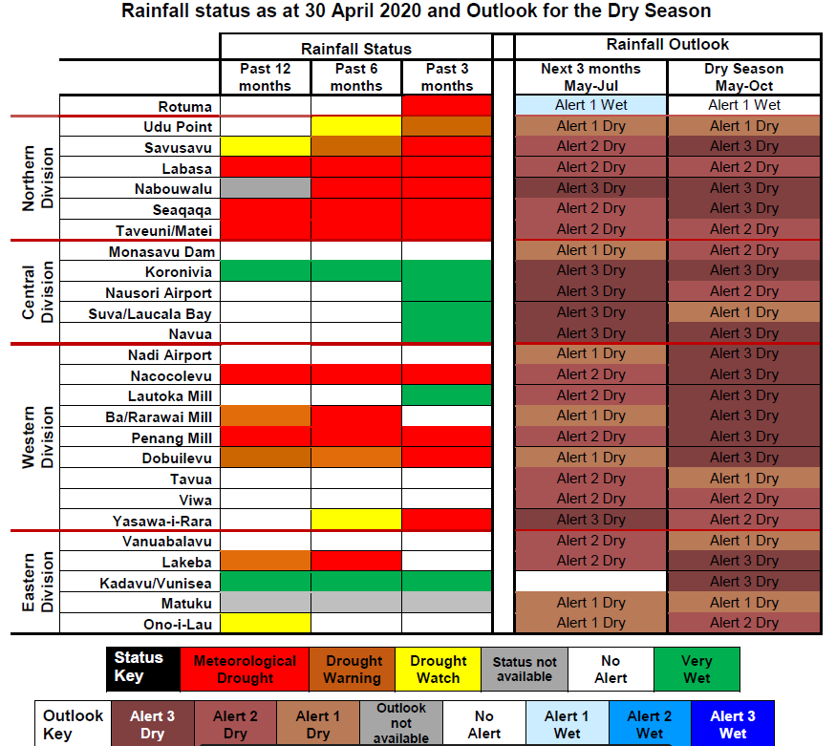
Working example
What could we say about Penang Mill?
'Meteorological drought existed at Penang Mill over the last 3-, 6- and 12- months'
'Alert 2 dry issued for May to July 2020 and Alert 3 dry for the on-coming dry season'
Based on the matrix we could say something like 'based on the recent rainfall status and outlook, meteorological drought at Penang is likely to continue over May to July'
BUT we need to check our 'need to knows'
Notes:
Percentile or SPI value and trend, status of ENSO, climatological trend

Slide 10
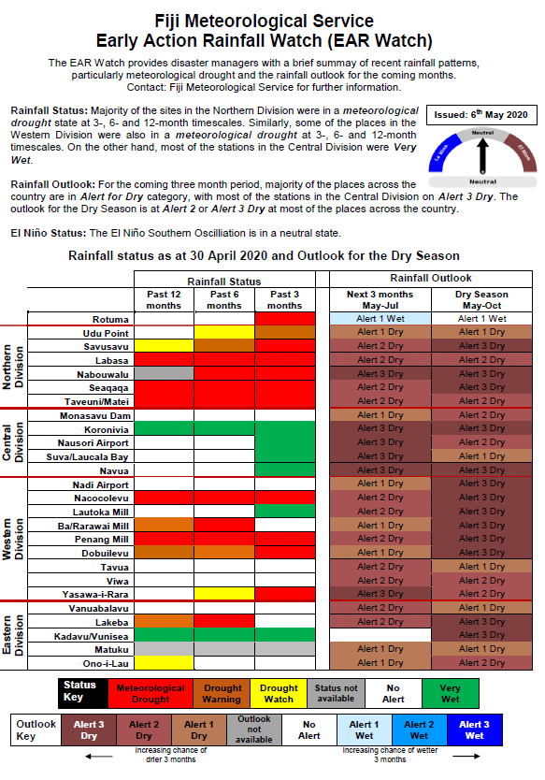
Working example
El Niño event is ended, not a coupled event. ENSO status currently neutral.
Notes:
Percentile or SPI value and trend, status of ENSO, climatological trend

Slide 11
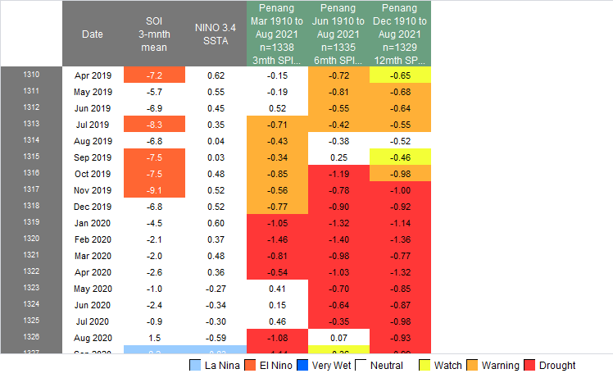
Working example
Drought trend at the end of April is 'heading out of drought'. Heading towards positive SPI values.
Notes:
Percentile or SPI value and trend, status of ENSO, climatological trend

Slide 12
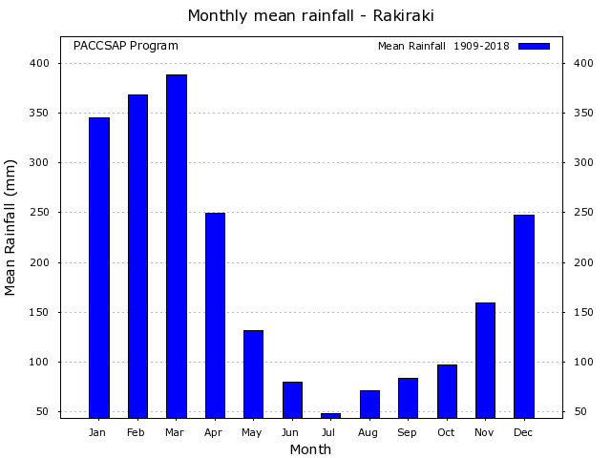
Working example
Heading into the peak of the dry season
One more factor to consider. Forecast source? If SCOPIC, only considering recent two months of NINO3.4
Apply your climatologist knowledge
What would you do? Would you add 'based on the recent rainfall status and outlook, meteorological drought at Penang is likely to continue over May to July' to your summary?
Notes:
Percentile or SPI value and trend, status of ENSO, climatological trend

Slide 13
Working example
Not in drought
Final comment. If you use this matrix, best not to apply it across timescales.
Notes:
Percentile or SPI value and trend, status of ENSO, climatological trend

Slide 14
5 minute exercise
Use the matrix to create a summary statement for one location in your own EAR Watch. For example, a location that is likely to proceed to drought, where drought is likely to ease, where drought is likely to continue, or where a wet period is likely to continue.
Don’t forget to consider likely environmental impacts in your statement

