Slide 1
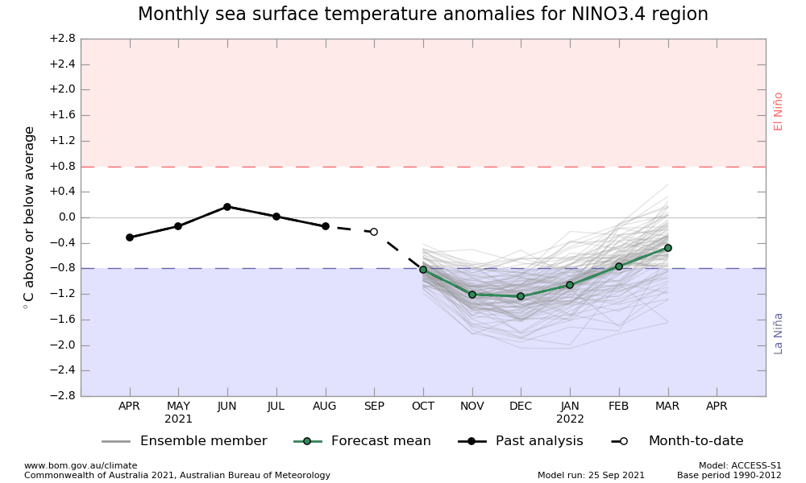
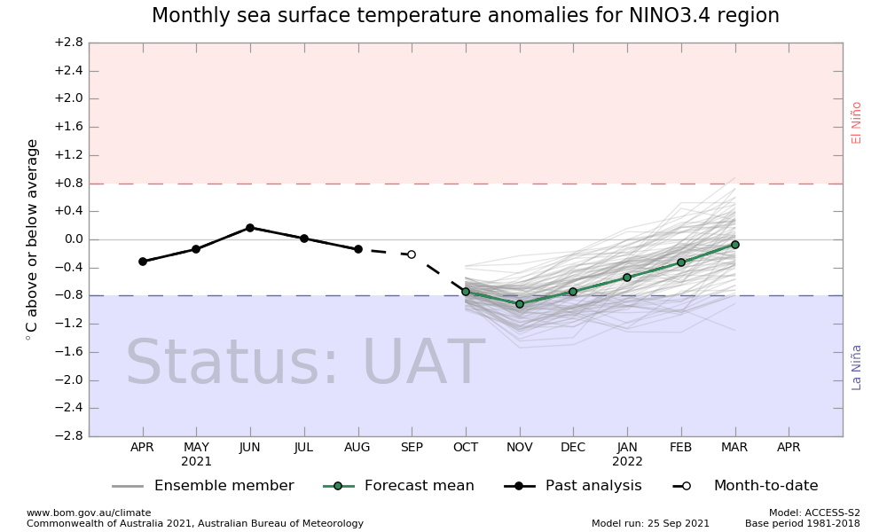
ACCESS-S2
ACCESS-S model will move from version 1 to version 2 on the 18th October. Version 1 will cease to be operational immediately.
Web content (http://access-s.clide.cloud/ ) will move to ACCESS-S2 from the 19th of October for Tropical Cyclone forecasts. Sub-seasonal to seasonal outlooks will be updated on the 20th of October.
All website products including data and maps will remain available and in the same location
Key changes – increased climatology period 1981-2018, update to data assimilation and initial conditions which have been demonstrated to increase forecast accuracy for rainfall, temperature and SST's in the tropics and at multiweek timescales

