Slide 1
ACCESS-S Workshop
MODULE: Statistics Fundamentals

Slide 2
Topics in this module
Mean / average
Anomalies
Median
Quantiles and distributions
Correlation
Statistically significant correlation
Root Mean Square Error
Expected learning outcomes
Understanding the mean, median and anomalies and how to calculate them
Understanding distributions and their relationship to probability
Understanding how to calculate statistical significance for trend lines and correlations

Slide 3
Correlation – how related are two variables?
We test a dependent variable's relationship with an independent variable
Example: Rainfall (dependent); ENSO (independent)
The Correlation Coefficient (r) measures the strength of the relationship – it can vary between –1 and +1
Values of –1 and +1 are perfect in which all the observations lie on a straight line
Positive correlation: dependent variable increases as the independent variable increases
Negative correlation: dependent variable decreases as the independent variable increases
r relates to the scatter of observations about the regression line of best fit
Correlation does not imply Causation
Correlation can be used to calculate model skill

Slide 4
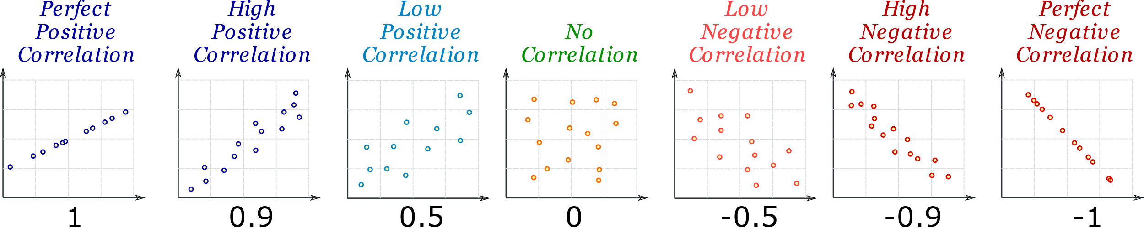
Correlation coefficient examples
The number below each graph is the value of r, the correlation coefficient

Slide 5
Using excel to calculate the correlation
What is the correlation between ENSO and rainfall at Honiara?
Use Excel to test the correlation of November to March Honiara rainfall compared to the November to December NINO3.4.
To calculate the correlation coefficient between two arrays of numbers: the formula is =Correl(array1:array2)
There is a negative correlation between the Nov-Dec value of NINO3.4 and the total Nov-March rainfall at Honiara.
Excel calculates –0.58782 for r. If we square this, we get the R² value shown on the graph.
But is it statistically significant?
Honiara rainfall for Nov-March (mm)
November-December NINO3.4

Slide 6
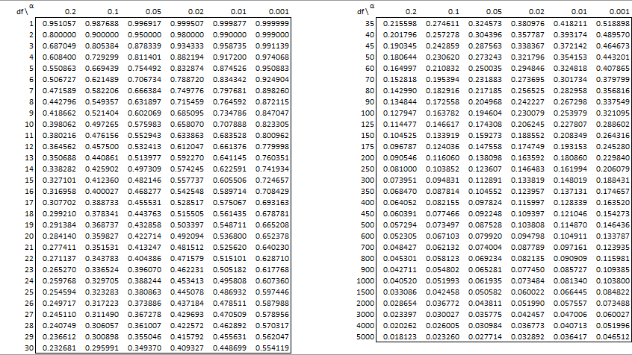
Using significance tables for correlation significance
The correlation coefficient (r) can be checked against a table of critical r values for different levels of significance [e.g. 0.05 (5%) or 0.01 (1%)] and degrees of freedom (df)
degrees of freedom (df) = n – 1, where n is the number of points on the graph, i.e. the sample size
For example, a sample with 60 degrees of freedom needs a correlation of at least 0.3248 (positive or negative) to be significant at the 1% level. Significant at the 1% level is a high level of confidence.
Tables of critical r values can be found on the internet.

Slide 7
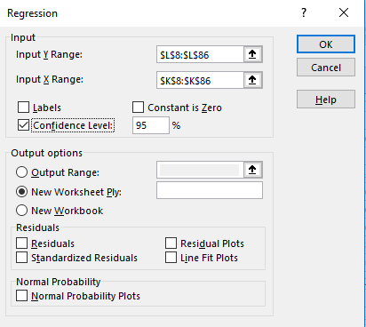
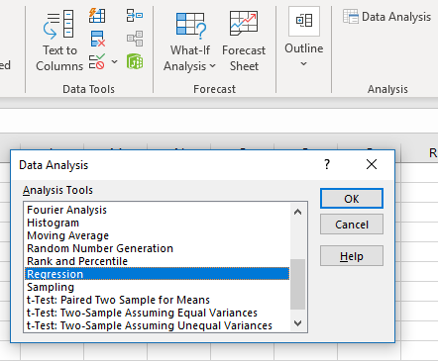
How to calculate if the correlation is significant
Use Data Analysis in Excel
Select 95% Confidence Level
Variable X = November- December NINO3.4
Variable Y = November-March rainfall
No Blank Cells. Excel returns an error if there are blanks

Slide 8

Using excel for correlation significance
Check for Significance
Our Honiara-NINO3.4 data has
64 degrees of freedom
Our critical r value will lie roughly half way between the two lines highlighted from the table
Our r value of –0.58782 is highly significant, even at the 0.001 (0.1%level).
Using the Excel Regression Analysis returns a P value of
2.63 x 10^{–7}. This confirms the highly significant nature of the correlation.

Slide 9
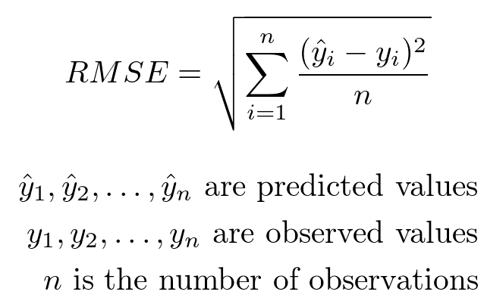
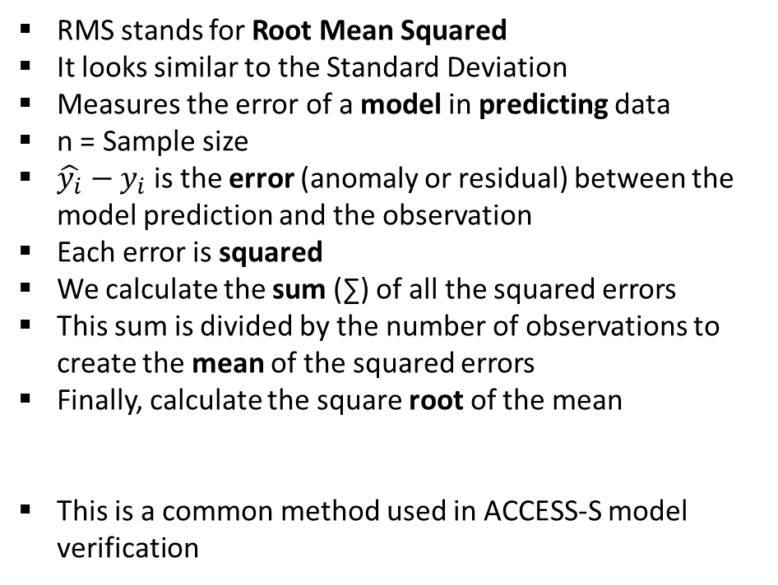
Root Mean Square Error
RMS stands for Root Mean Squared
It looks similar to the Standard Deviation
Measures the error of a model in predicting data
n = Sample size
$\hat{y_{i}}$ $−$ $y_{i}$ is the error (anomaly or residual) between the model prediction and the observation
Each error is squared
We calculate the sum (∑) of all the squared errors
This sum is divided by the number of observations to create the mean of the squared errors
Finally, calculate the square root of the mean
This is a common method used in ACCESS-S model verification
Notes:
What variable in model verification is this used for?

Slide 10
Significance and Correlation summary
Statistical significance is important for:
Trends in which one variable is plotted against time (e.g. climate change)
Correlation in which two variables are plotted against each other (e.g. NINO3.4 and rainfall)
Significance for trends is calculated using a linear line of best fit through the data to see how it changes over time (e.g. temperature over time)
Significance for correlation measures the strength of a relationship between a dependent and independent variable (e.g. rainfall and NINO3.4)
Excel can be used to calculate statistical significance

