Slide 1
ACCESS-S Workshop
MODULE: Pacific climate drivers

Slide 2
Topics in this module
El Niño–Southern Oscillation (ENSO)
Madden–Julian Oscillation (MJO)
Expected learning outcomes
Understanding of the main climate drivers that affect the Pacific
These outcomes are important for understanding and interpreting ACCESS-S outputs and products such as the tropical cyclone outlook and ENSO

Slide 3
El Niño – Southern Oscillation (ENSO)
ENSO is the dominant driver of natural climate variability.
ENSO is strongly linked to the seasonal cycle; this is the source of the predictability.
El Niño = broad scale warming of water in the central and eastern tropical Pacific Ocean.
La Niña = a broad scale cooling of water in the central and eastern tropical Pacific Ocean.
Rain often occurs over the warmest waters.

Slide 4
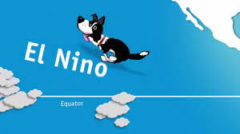
El Niño – Southern Oscillation (ENSO)
Video - https://www.climatekelpie.com.au/index.php/climatedogs/

Slide 5
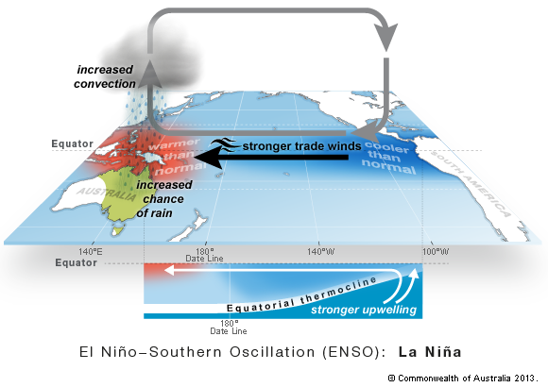
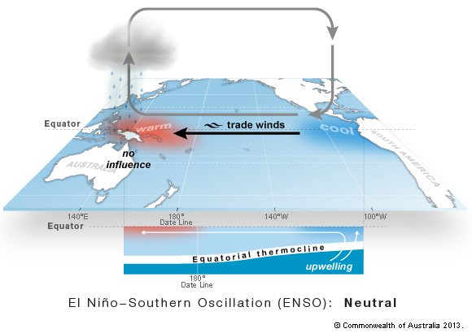
Circulation changes associated with La Niña
Walker Circulation becomes stronger and moves west during La Niña
Rain and cloud follows Western Pacific Warm Pool
Stronger trade winds increase upwelling in eastern Pacific.
Equatorial Pacific Cold Tongue develops and strengthens
Bringing increased temperature contrast between west and east along the equator
Atmosphere and ocean act together in sync (COUPLED)
Neutral
La Niña
Walker Circulation
Warmer waters in the west, cooler waters in the east.

Slide 6
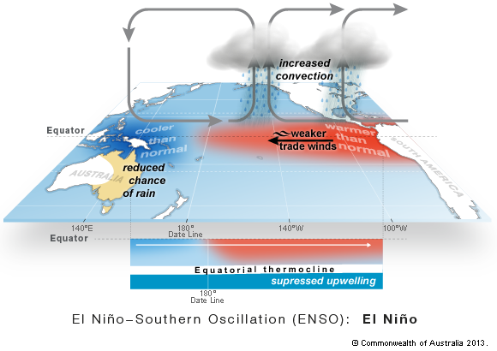
Circulation changes associated with El Niño
El Niño
Changes in the ocean temperatures
POSITIVE FEEDBACK loop
Changes in the wind
Rain and cloud follow warmest waters
Walker Circulation weakens, moves east and sometimes reverses during an El Niño
The Western Pacific Warm Pool moves east, dragging the cloud and rain with it
ENSO events develop in autumn to winter and decay in summer.
ENSO lifecycle is a source of predictability in the Pacific.
Notes:
Key Learning Outcomes:
Rain and cloud follow the warmest waters → causes changes in the winds → causes changes in the ocean temperatures → causes changes in the rain and cloud etc. The process is self-reinforcing = POSITIVE FEEDBACK. El Nino and La Nina events are COUPLED modes of the Pacific climate system. That is, the ocean and atmosphere act together.
The effects of ENSO spread beyond the equatorial regions (e.g. to Australia and the USA); these remote effects are called TELECONNECTIONS.
The east-west atmospheric circulation loop is called the WALKER CIRCULATION.
ENSO events usually develop around the middle of the year, reach maturity around December or January and then decay to neutral by around April or May. This typical life cycle is the source of the climate predictability across the Pacific.

Slide 7
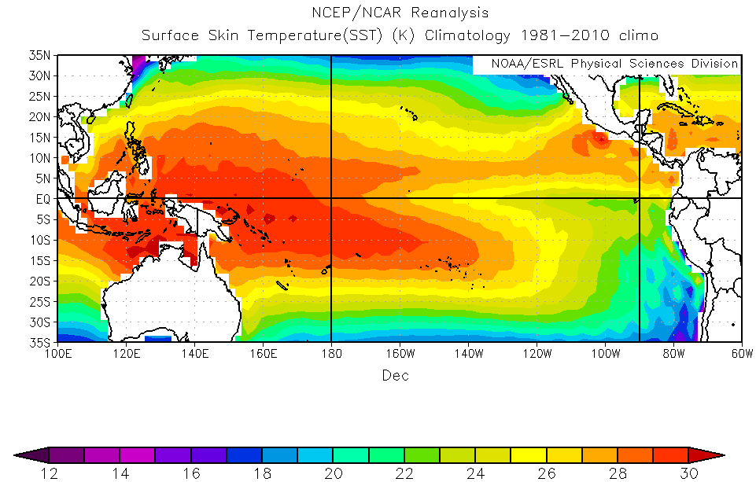
Average December Sea Surface Temperature (SST) pattern during a neutral ENSO phase
East equatorial Pacific is
cooler than west
WPWP
ITCZ
Cold tongue
SPCZ
Cold current
Notes:
This is the December average SST pattern over 1981-2010.
Note the axes of the ITCZ and SPCZ are reflected in the SSTs.
Main Features
WPWP
The axes of the ITCZ and SPCZ are reflected in the SSTs
Equatorial Pacific Cold Tongue
Cold current along the west coast of South America

Slide 8
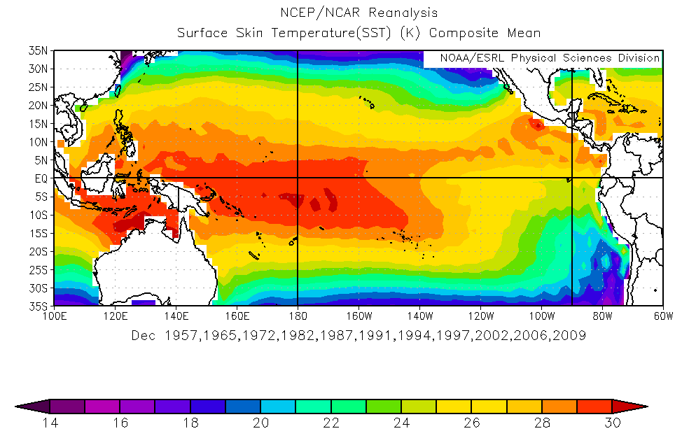
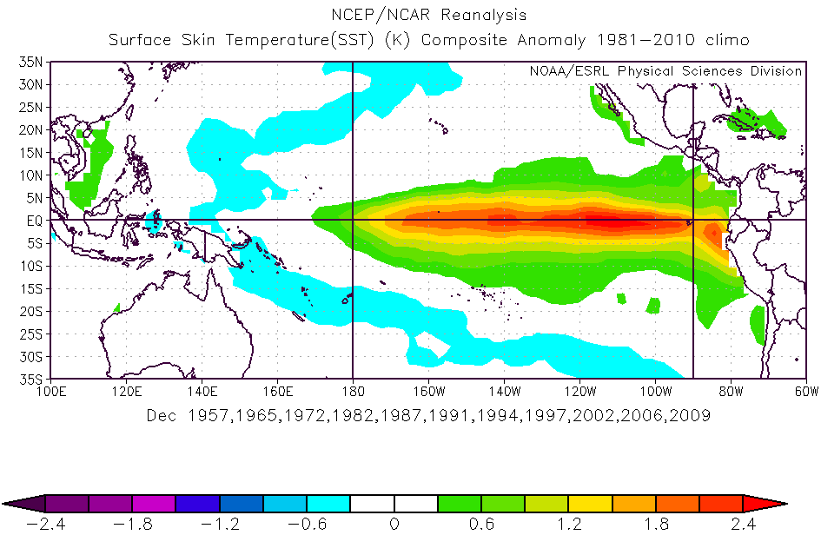
Average December Sea Surface Temperature patterns and anomaly during El Niño
WPWP
Warmer than normal
Average of 11 El Niño events
Western Pacific Warm Pool has spread east into the central Pacific (29°C east of 160°W)
Temperature difference between east and west equatorial Pacific is about 4°C
Sea Surface Temperatures in the central and eastern Pacific are typically above normal
Boomerang-shaped region of cooler water to the west around the warm equatorial waters
Notes:
This is a December average pattern over 11 El Nino events; December is commonly the month of peak warming.

Slide 9
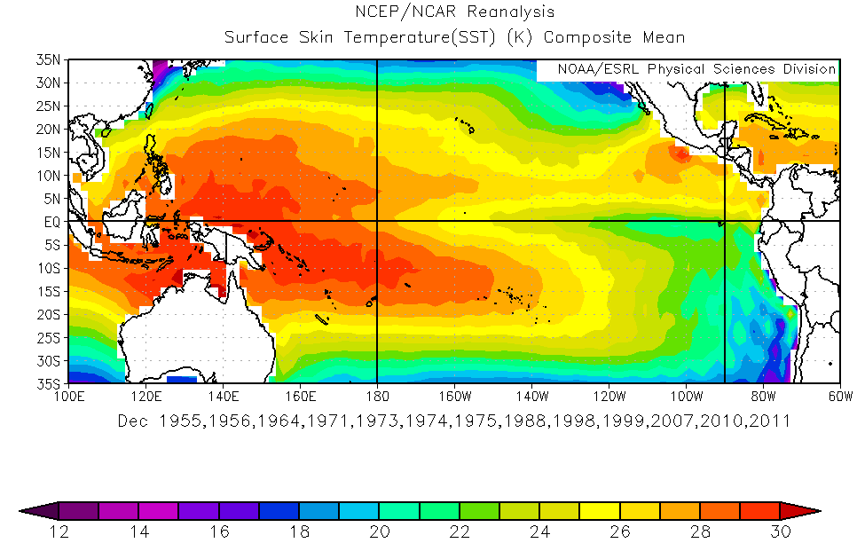
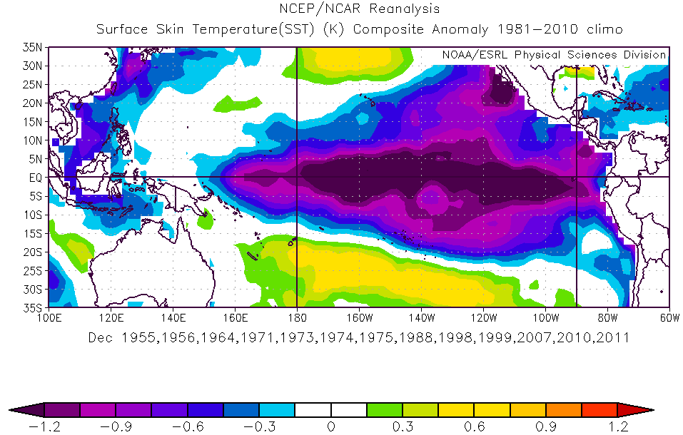
Average December Sea Surface Temperature patterns and anomaly during La Niña
WPWP
further west
Cooler than normal
Western Pacific Warm Pool has contracted to the far western Pacific. The water above 29°C is more than 40° of longitude west compared to El Niño average.
Equatorial Pacific Cold Tongue is stronger and further west
Sea Surface Temperatures are typically below normal within about 15° of the equator, east of 160°E. Almost the reverse of El Niño but not symmetrical.
Boomerang-shaped region of warmer water wrapping around the cool equatorial waters
Notes:
This is a December average pattern over 13 La Nina events to compare with the El Nino composite.
During a La Nina, SSTs in the central and eastern pacific are typically below normal.

Slide 10
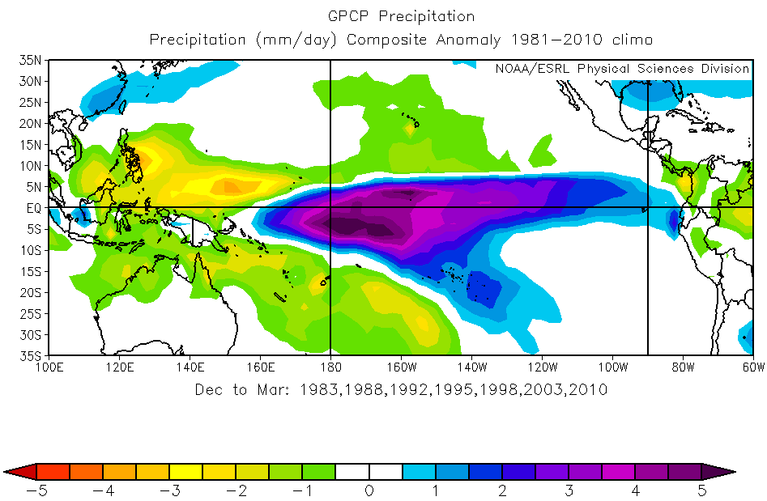
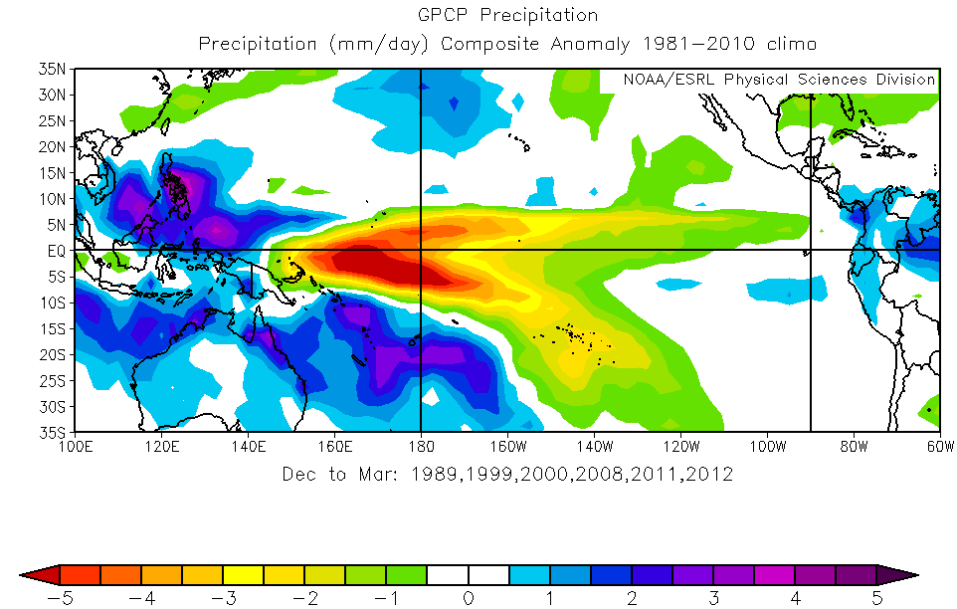
Average El Niño and La Niña rainfall patterns (mm/day) December - March
El Niño
La Niña
Rainfall ↑ across the equatorial Pacific east of 160°E over the anomalously warm water
Rainfall ↓ southwest and northwest Pacific, Maritime Continent and northern Australia
ITCZ is shifted south, SPCZ is shifted northeast
Rainfall ↓ across much of the equatorial Pacific east of 150°E over the anomalously cool water
Rainfall ↑ southwest and northwest Pacific, Maritime Continent and much of Australia
ITCZ is shifted north, SPCZ is shifted southwest
Notes:
Rainfall is strongly influenced by SSTs.
Note that the maximum rainfall anomaly is NOT found over the maximum SST anomaly. Rather, it is close to the maximum actual SST.
The mean La Nina rainfall pattern is almost the reverse of the El Nino pattern.
During a La Nina, decreased rainfall is typically found in the central and eastern Pacific over the anomalously cool water, with a corresponding increase in rainfall across the southwestern Pacific and the maritime continent.

Slide 11
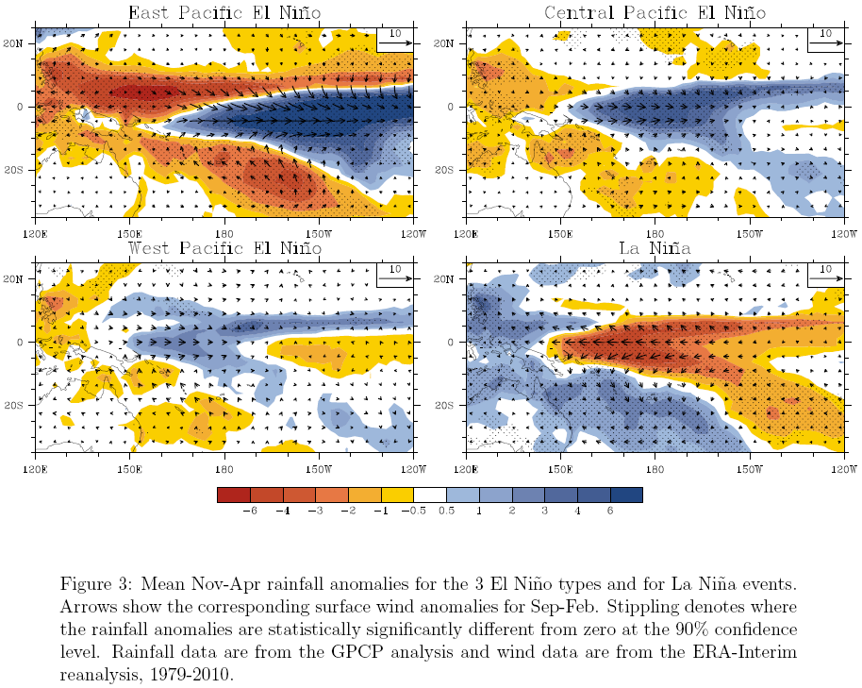
El Niño – three different types
La Niña – one type
East Pacific El Niño
Central Pacific El Niño
East Pacific (classic) El Niño: large ‘wedge’ of higher than normal rainfall emerging from South America coast with boomerang of low rainfall to the west
Central Pacific El Niño: ‘Modoki’ El Niño with increased rainfall in the centre of the Pacific
West Pacific El Niño
La Niña
West Pacific El Niño: higher than normal rainfall extending further north and west than for central Pacific event. Generally the weakest of the 3 types.
La Niña generally has one form
The type of ENSO event affects where rainfall will occur
Notes:
Recent research suggests that there are actually 3 distinct types of El Nino patterns.
East Pacific El Nino is exemplified by a large ‘wedge’ of higher than normal SSTs emerging from the South American coast (see 1997 El-Nino event)
The Central Pacific El Nino is the ‘typical’ El Nino with increased SSTs in the centred on the Central Pacific.
The West Pacific El Nino is exemplified by higher than normal SSTs extending further north and west than for a typical El Nino.
La Nina generally has one form.

Slide 12
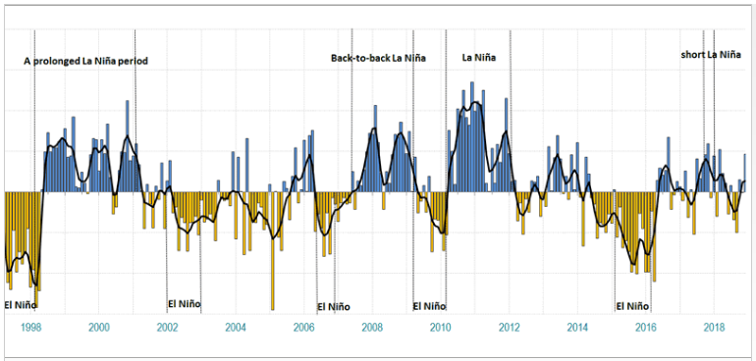
Tracking ENSO – Southern Oscillation Index (SOI)
Difference in air pressure between Tahiti and Darwin
SOI is a sign of the Walker Circulation
Sustained SOI of +7 → La Niña
Sustained SOI of −7 → El Niño
Understanding SOI = understand ENSO event
Notes:
Standardised anomaly of the difference in air pressure between Tahiti and Darwin. This is a good proxy for the strength of the Walker Circulation.

Slide 13
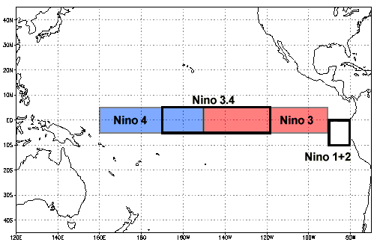
Tracking ENSO – Sea Surface Temperatures (NINO Indices)
One way ENSO is monitored is by looking at particular areas of the Pacific Ocean
The NINO indices give a summary of the equatorial Sea Surface Temperatures (SSTs), and the state of ENSO
The SST anomaly in the box is averaged.
Thresholds for El Niño and La Niña events are about +0.8°C and –0.8°C respectively, for NINO3 and NINO3.4
NINO3.4 is most commonly used for tracking ENSO

Slide 14
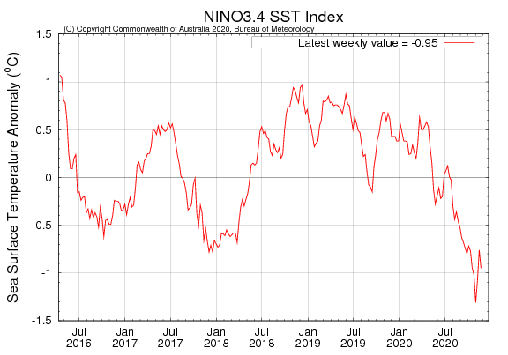
Tracking ENSO – NINO Indices
NINO3.4 (2002 – 2021)
Above (from NOAA-CPC): gives long-term (20-year) perspective
Right (from BoM): gives recent (4-year) perspective
Notes:
NOAA-CPC: https://www.cpc.ncep.noaa.gov/products/CDB/Tropics/figt5.gif

Slide 15
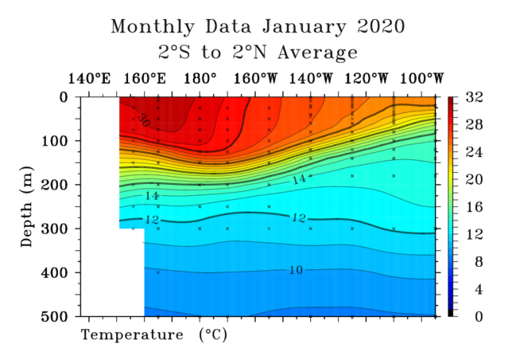
Tracking ENSO – Sub-surface temperatures ENSO neutral
Warm waters deeper in west
29°C at 100m depth
Warm waters shallow in east
15°C at 100m depth
Strongest temperature gradient (i.e. isotherms are bunched together) is called the thermocline – the 20°C isotherm sits very close to the middle of the thermocline
Thermocline: is deepest in the west and shallowest in the east, so that it slopes upwards from west to east
Sub-surface temperature profile from Global Tropical Moored Buoy Array
Notes:
https://www.pmel.noaa.gov/tao/drupal/disdel/

Slide 16
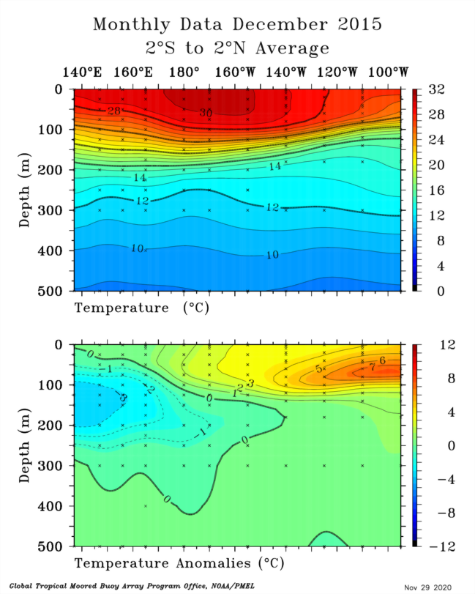
Tracking ENSO – Sub-surface temperatures El Niño
Warmest waters in central Pacific
Thermocline is flatter than average shallower in west and deeper in east. Warm water has moved into the eastern Pacific.
Strong positive temperature anomalies in the eastern Pacific are a typical signature of a mature strong El Niño
Negative temperature anomalies developing in the west and undercutting the positive anomalies are another typical sub-surface sign of El Niño
Strong El Niño: December 2015
Notes:
https://www.pmel.noaa.gov/tao/drupal/disdel/

Slide 17
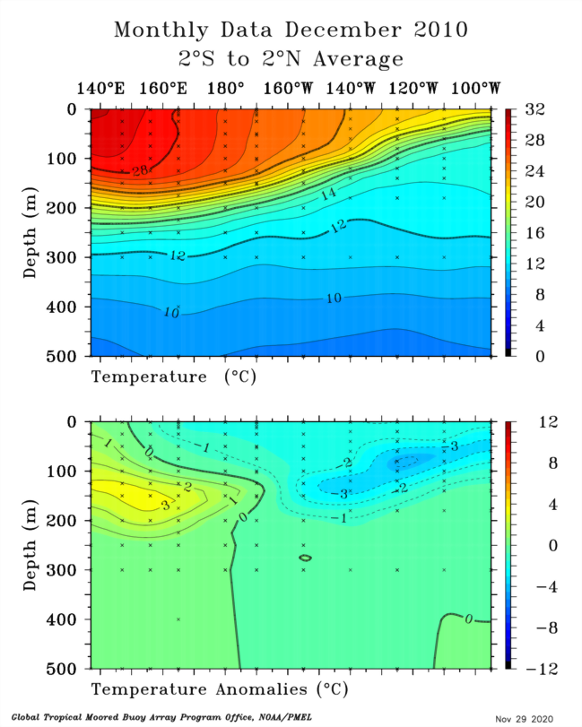
Tracking ENSO – Sub-surface temperatures La Niña
Warmest waters shifted to west
Thermocline is steeper than average deeper in west and shallower. Cool water is upwelling in east.
Strong negative temperature anomalies in the eastern Pacific are a typical signature of a mature strong La Niña
Positive temperature anomalies developing in the west and undercutting the negative anomalies are another typical sub-surface sign of La Niña
Strong La Niña: December 2010
Notes:
https://www.pmel.noaa.gov/tao/drupal/disdel/

Slide 18
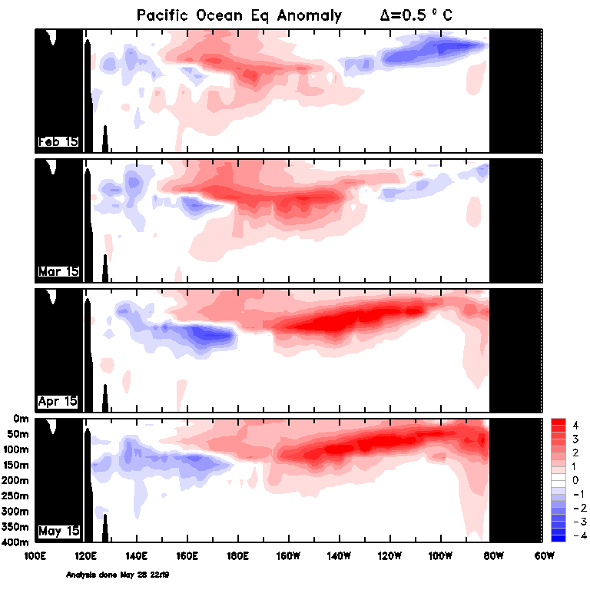
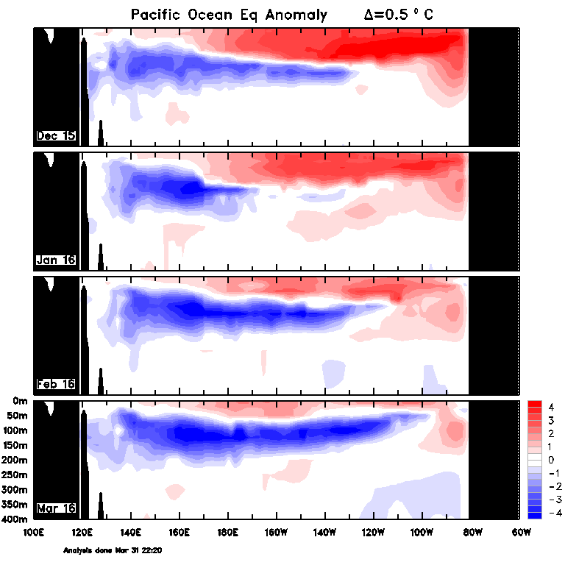
El Niño: four-month sequences development and decay: sub-surface temperature
El Niño Development Phase El Niño Decay Phase
Feb 15
Dec 15
Warmer than normal water moves east with time
Cooler waters upwell in the east with time
Mar 15
Jan 15
Apr 15
Feb 15
May 15
Mar 15

Slide 19
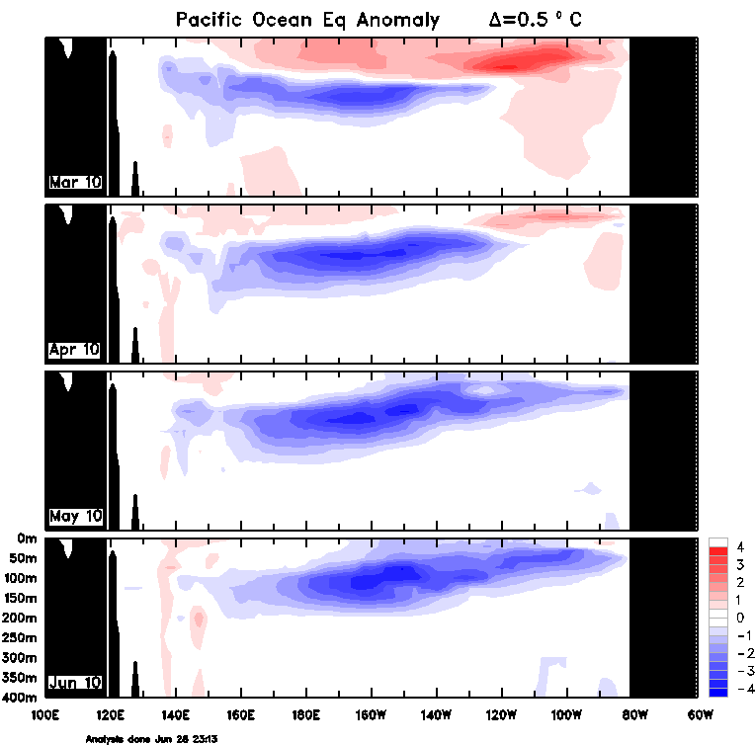
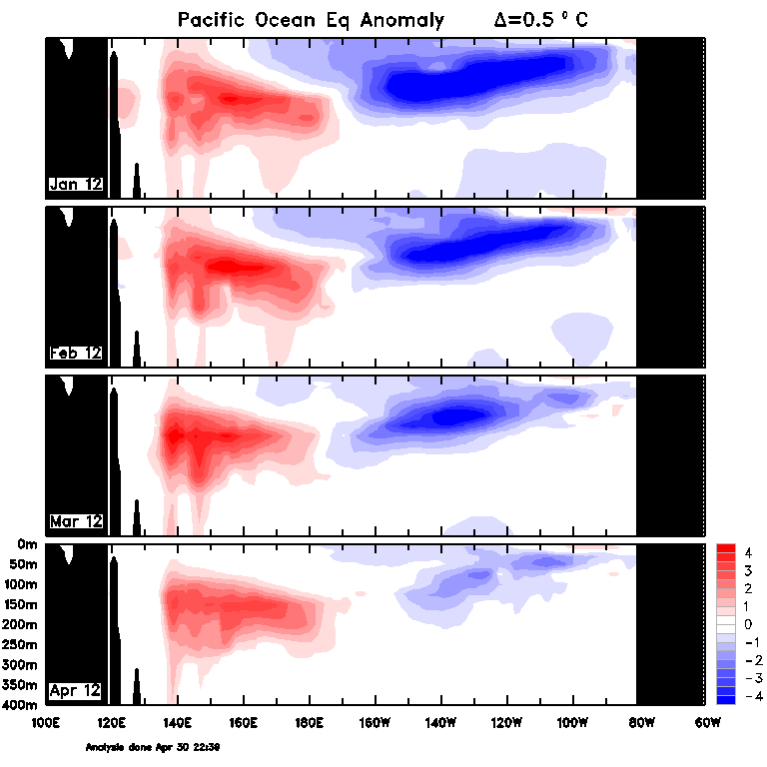
La Niña: four-month sequences, development and decay: sub-surface temperatures
La Niña Development Phase La Niña Decay Phase
Mar 10
Cooler than normal water becomes dominant
Cooler than normal waters become less dominant in the east
Apr 10
May 10
Jun 10

Slide 20
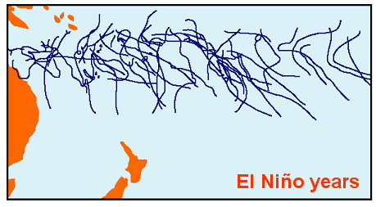
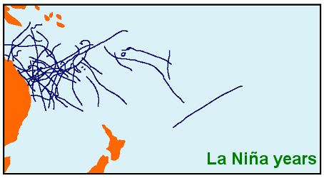
ENSO and Tropical Cyclones
Cyclogenesis requires Sea Surface Temperatures (SSTs) higher than 26.5°C
Intensity of cyclones linked to higher SSTs
El Niño: higher SSTs in Central Pacific, increased cyclogenesis in this region = Tropical Cyclones spread out
La Niña: cyclogenesis region pushed into Western Pacific due to lower SSTs in Central Pacific = Tropical Cyclones closer together

Slide 21
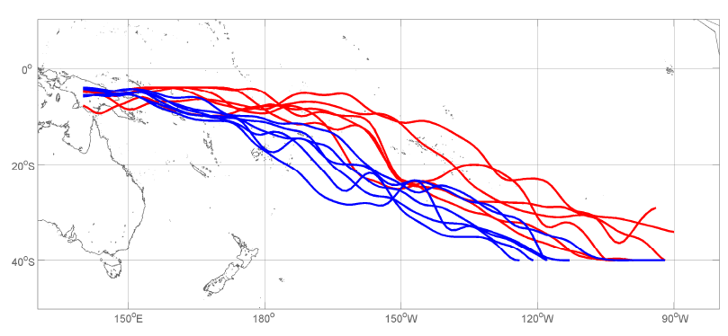
ENSO and the South Pacific Convergence Zone (SPCZ) (from James Renwick & Brett Mullan, NIWA, N.Z.)
El Niño
La Niña
Shift in SPCZ position = large rainfall variability in affected countries
Notes:
Neutral years tend to fall in the middle.

Slide 22
Tracking & Monitoring ENSO Summary
El Niño:
The Walker Circulation and trade winds weaken.
Ocean temperatures become warmer than average in the central and eastern Pacific.
The Southern Oscillation Index (SOI) remains negative for several consecutive months.
Cloud and rainfall increase over the central and east Pacific. Decreases in the west - over Australia, Indonesia, Solomon Islands etc.
La Niña:
The Walker Circulation and trade winds strengthen.
Ocean temperatures become cooler than average in the central and eastern Pacific.
The Southern Oscillation Index (SOI) remains positive for several consecutive months.
Cloud and rainfall decrease over the central and east Pacific. Increases in the west - over Australia, Indonesia, Solomon Islands etc.
Discussion questions
Why are there multiple ways to track ENSO?
What role do the trade winds have in sea surface temperatures and rainfall?
How would you plan for a La Niña event?
Would your country have more tropical cyclones during El Niño or La Niña?

Slide 23
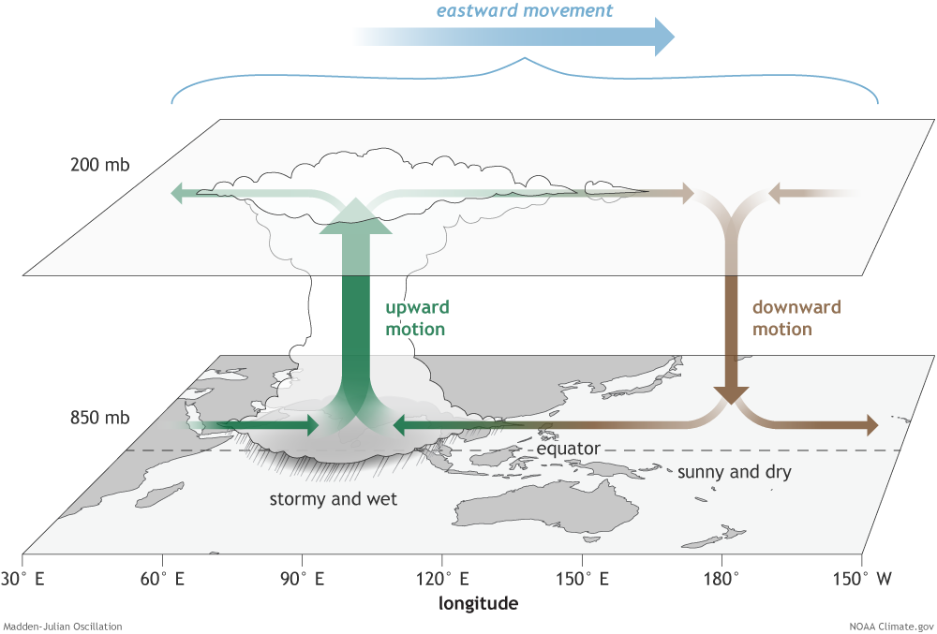
The Madden-Julian Oscillation (MJO)
Starts over western Indian Ocean and moves east over the western and central tropical Pacific.
Features enhanced rainfall followed by a dry phase
Cycle around the globe lasts 30–60 days
Brings active and break phases of the monsoon or wet season
Increased chance of Tropical Cyclones
Winds from MJO can help El Niño development
More active in southern summer/autumn
© Commonwealth of Australia 2021. Bureau of Meteorology
Notes:
MJO first studied in the 1970s. It’s the strongest mode of intraseasonal variability on Earth.
The MJO is characterized by an eastward progression of large regions of both enhanced and suppressed tropical rainfall, observed mainly over the Indian Ocean and Pacific Ocean.
The anomalous rainfall is usually first evident over the western Indian Ocean and remains evident as it propagates over the very warm ocean waters of the western and central tropical Pacific.
The wet phase of enhanced convection and precipitation is followed by a dry phase where thunderstorm activity is suppressed. Each cycle lasts approximately 30–60 days.
Alternative Names: 30-60 day wave, 40-50 day wave, intra-seasonal oscillation.
Why is it important?:
Brings active and break phases of the monsoon or wet season.
Increases the chance of tropical cyclones.
Associated westerly wind burst (WWB) can play a critical role in the development of El Nino events
More active in the southern summer/autumn.
Generally less prevalent during ENSO events, especially the stronger ones (either La Nina or El Nino)

Slide 24
The Madden-Julian Oscillation (MJO)
Video - https://www.climatekelpie.com.au/index.php/climatedogs/

Slide 25
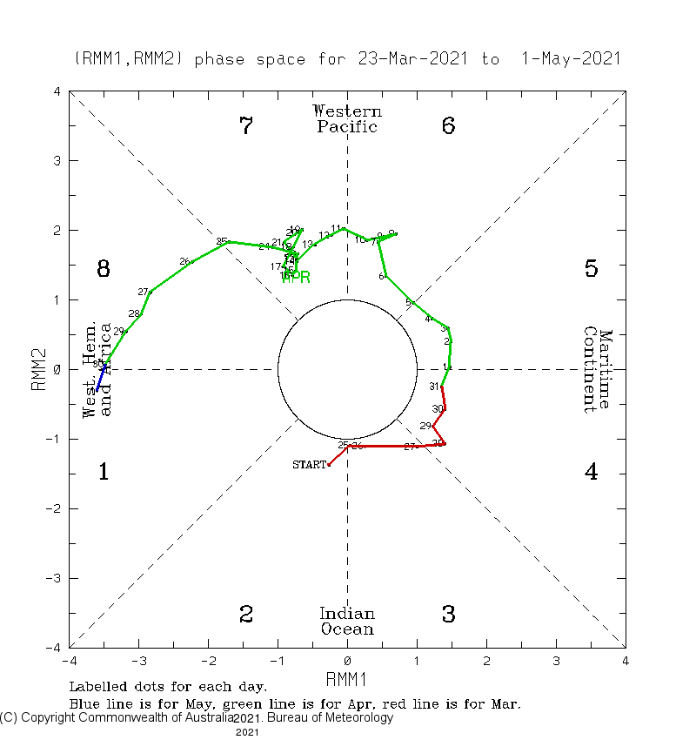
Monitoring Madden-Julian Oscillation (MJO)
MJO Phase Diagram – 40 days
Uses wind and cloud observations
Daily strength of wind and cloud are calculated and plotted as a point on diagram. The small numbers are the dates. New colour for each month.
An active period of the MJO is when the points form an anti-clockwise spiral outside the centre circle.
The centre circle represents a weak or non-existent MJO signal. This example is a weak MJO
The edges of the diagram represents stronger MJO. This is an example of a strong MJO.
Notes:
Key Learning Outcome: Understanding the MJO phase monitoring diagram.
Dynamical model forecasts of the MJO Index – see http://www.cpc.ncep.noaa.gov/products/precip/CWlink/MJO/CLIVAR/clivar_wh.shtml .
MJO information: http://www.bom.gov.au/climate/mjo/ and
http://www.cpc.ncep.noaa.gov/products/precip/CWlink/MJO/mjo.shtml

Slide 26
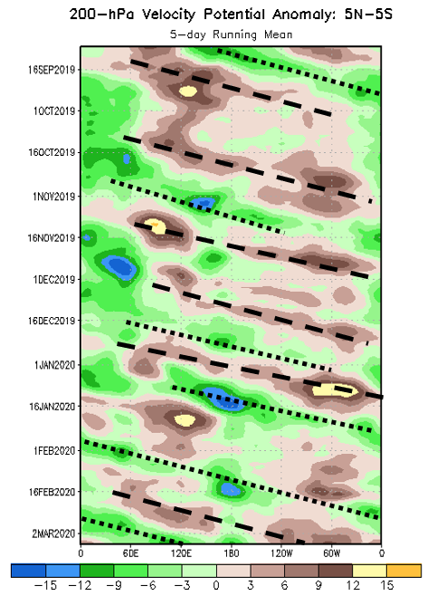
Monitoring the Madden-Julian Oscillation (MJO)
MJO Time-Longitude Plot
Brown/Yellow = less cloud and rain than normal
Green/Blue = more cloud and rain than normal
Time runs down the page
Areas of high or suppressed convection move from west to east through time
Dotted black lines show the propagation of active (wet) phase of the MJO
Dashed black lines show the propagation of inactive (dry) phase of the MJO
200 hPa Velocity Potential is related to the amount of convergence or divergence high in the atmosphere
Time
Notes:
Archive available at https://www.cpc.ncep.noaa.gov/products/precip/CWlink/MJO/ARCHIVE/PPT/

Slide 27
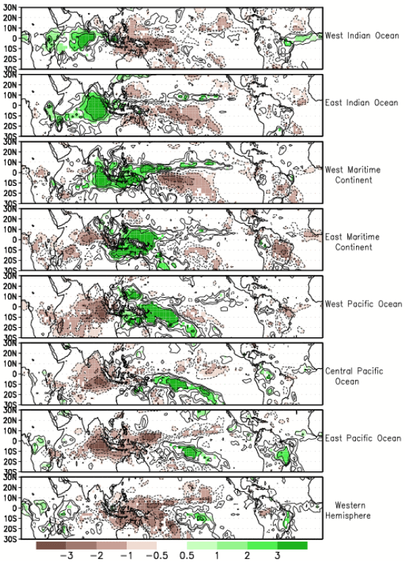
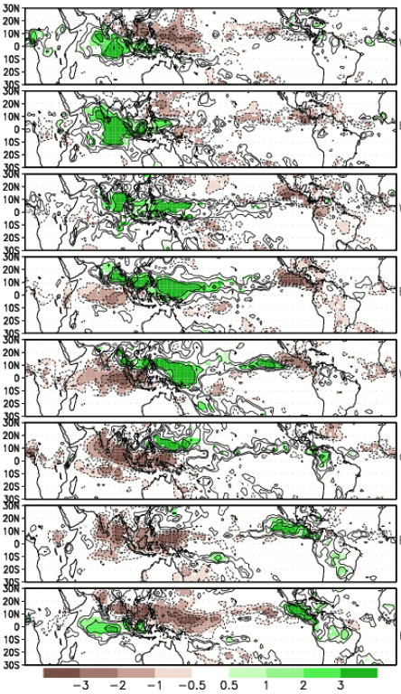
MJO Phase Averages Left: Nov-March Right: May-Sept Units: Rain mm/day Areas of higher rainfall move east with areas suppressed rainfall following behind
Phase
2
3
4
5
6
7
8
1
Notes:
Available at https://www.cpc.ncep.noaa.gov/products/precip/CWlink/MJO/MJO_summary.pdf

Slide 28
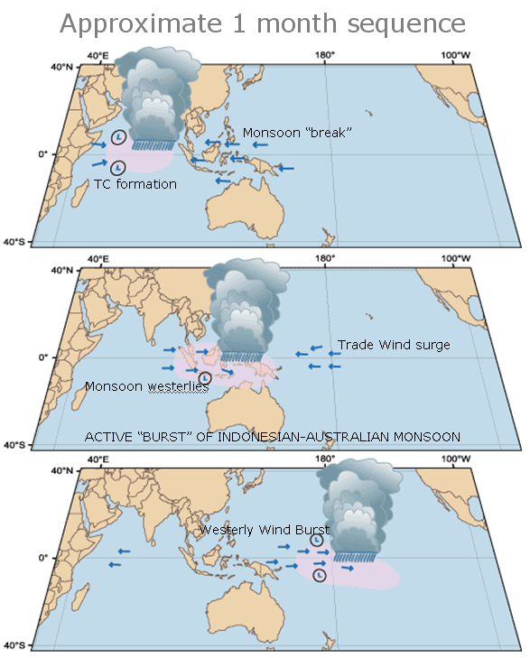
Madden-Julian Oscillation (MJO) summary
Topics covered
MJO moves from west to east around tropics
MJO has a 30-60 day cycle
Tracking MJO with phase diagram
Discussion questions
How can the position and strength of the MJO affect tropical rainfall?
Notes:
MJO first studied in the 1970s. It’s the strongest mode of intraseasonal variability on Earth.
The MJO is characterized by an eastward progression of large regions of both enhanced and suppressed tropical rainfall, observed mainly over the Indian Ocean and Pacific Ocean.
The anomalous rainfall is usually first evident over the western Indian Ocean and remains evident as it propagates over the very warm ocean waters of the western and central tropical Pacific.
The wet phase of enhanced convection and precipitation is followed by a dry phase where thunderstorm activity is suppressed. Each cycle lasts approximately 30–60 days.
Alternative Names: 30-60 day wave, 40-50 day wave, intra-seasonal oscillation.
Why is it important?:
Brings active and break phases of the monsoon or wet season.
Increases the chance of tropical cyclones.
Associated westerly wind burst (WWB) can play a critical role in the development of El Nino events
More active in the southern summer/autumn.
Generally less prevalent during ENSO events, especially the stronger ones (either La Nina or El Nino)

Slide 29
Indian Ocean Dipole (East Timor and PNG)
Video - https://www.climatekelpie.com.au/index.php/climatedogs/

Slide 30
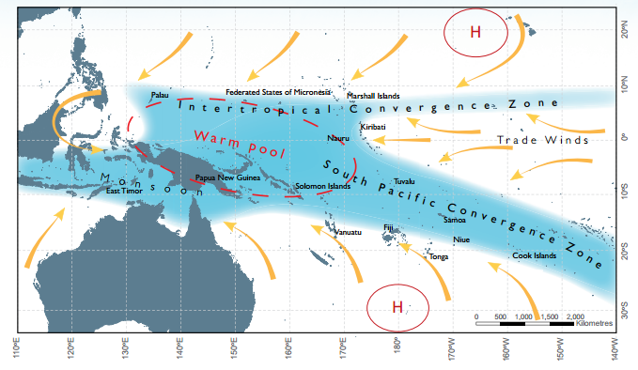
Pacific climate module summary
El Niño Southern Oscillation (ENSO)
Sea surface temperatures
Rainfall
Tracking
ENSO and Tropical Cyclones
ENSO and (SPCZ)
Madden-Julian Oscillation (MJO
Monitoring MJO
MJO Phases

