Slide 1
ACCESS-S Workshop
MODULE: Multi-week Tropical Cyclone forecasts

Slide 2
Outline: ACCESS-S multi-week TC outlooks
What can a multi-week TC outlook offer
Multi-week TC outlooks around the globe
Technical detail
How do we get a probabilistic outlook
Calibrating the model – what is a calibrated anomaly
Model skill assessment
Real time forecast examples
What not to do when interpreting TC outlooks
Guidance on interpretation
Scenario: using climate observations and forecasts together
Conclusion

Slide 3
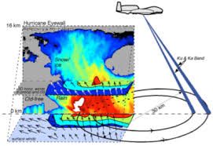
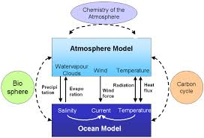
NWP vs Seasonal Climate Model for Tropical Cyclone forecasting: Bureau of Meteorology example
NWP (e.g. ACCESS-GE2) | Seasonal climate model (e.g. ACCESS-S1)
Sophisticated atmospheric data assimilation scheme to initialise the ensemble members | Simpler atmospheric data assimilation
Fixed ocean Sea Surface Temperatures | Dynamic ocean model (which is coupled to the atmosphere) which allows it to make long-range forecasts
Skill is higher, but it only runs out to 10 days | Skill is lower initially but it can be run out for multiple weeks

Slide 4
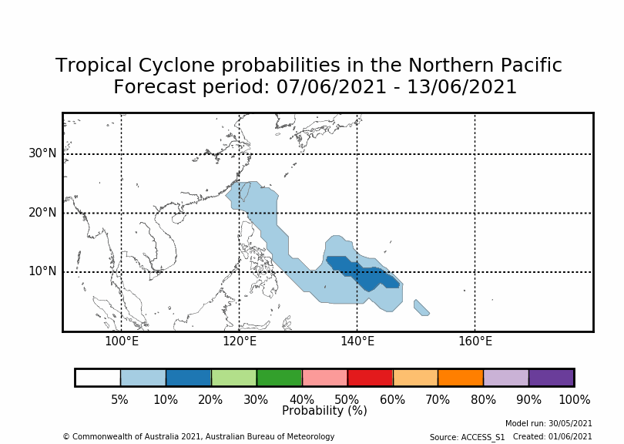
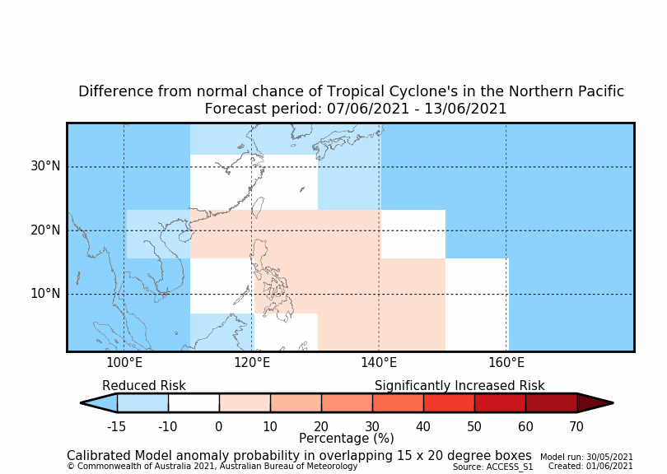
ACCESS-S multi-week TC outlooks key points
Multiweek TC outlooks: Extending the forecast beyond NWP
Outlooks are presented as probabilities similar to climate outlooks
Week 1 (day 1-7): use your NWP forecast, this has the best skill
Week 2/3 (day 8-14, day 15-21): probabilistic forecasts have good skill in the Pacific basin
Week 4 (day 22-28): good skill in the Western North Pacific

Slide 5
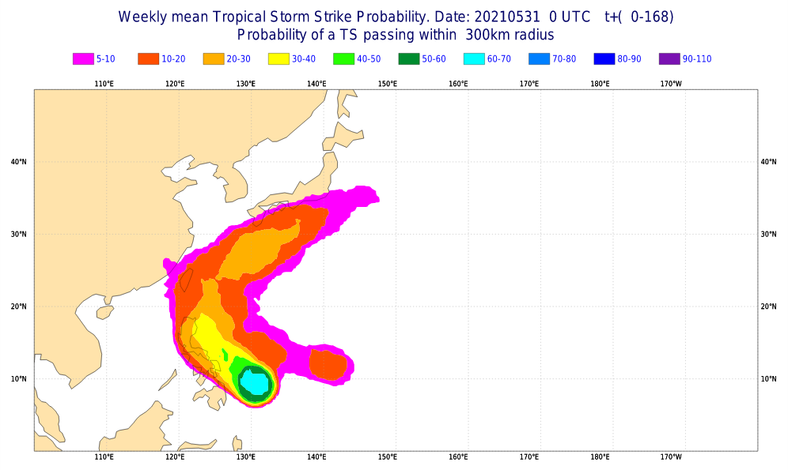
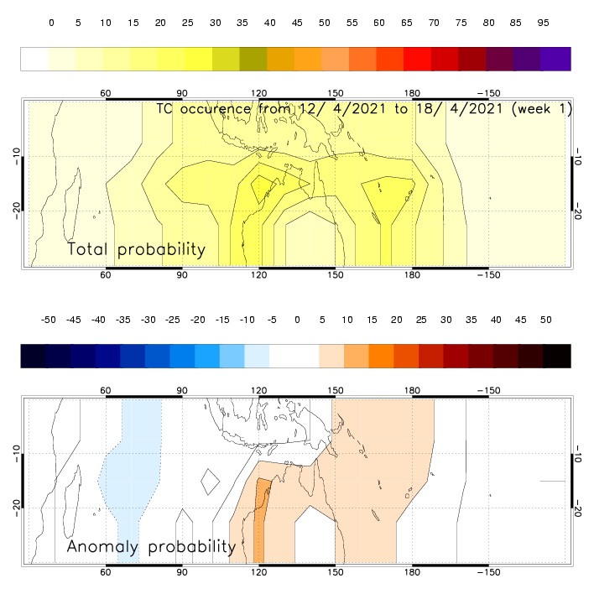
Where in the World: Tropical Cyclone outlooks
Dynamical model forecasts issued by ECMWF (2012) and BoM (2020)
Statistical-based forecasts offered by Meteo-France based on relationships between climate drivers such as the MJO and TC formation
Dynamical models (ECMWF & BoM) do not currently have adequate skill at seasonal or TC season timescales. Therefore it is recommended that statistical outlooks are preferred at seasonal timescales
On a multi-week timescale the MJO is a major driver of TC variability, and ACCESS-S shows high skill for predictions of the MJO meaning the model is able to 'reproduce the enhanced modulation of TC activity by the MJO in the Southern Hemisphere'

Slide 6
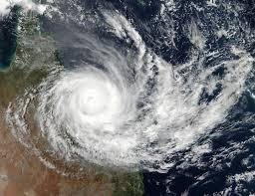
ACCESS-S TC's: Technical detail
ACCESS-S1:
Run 33 x per day (11 run for six months while the remaining 22 for 42 days)
Provide guidance from days 4-28, though skill is highest early in the forecast period.
TC tracker system needs 72 hours to identify a storm (no forecasts before day 4), conditions must be satisfied for at least 48 hours before a TC is considered to have formed.
TC obs For calibration and verification purposes
- International Best Track Archive for Climate Stewardship – WMO (ICTrACS-WMO) 1981-2010
Real-time track data from NOAA for 2017 – 2019
https://journals.ametsoc.org/waf/article/35/5/1817/353805/Subseasonal-Forecasts-of-Tropical-Cyclones-in-the

Slide 7
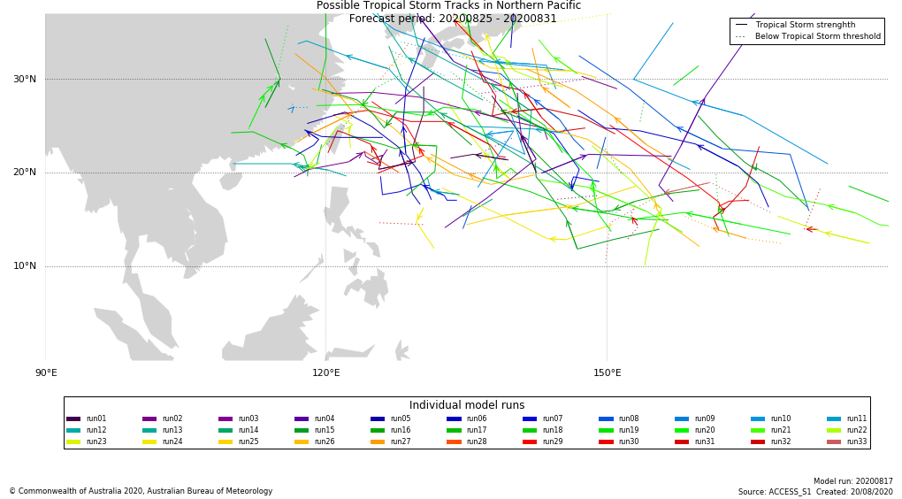
ACCESS-S TC's: Technical detail
Tracker System:
ACCESS-S uses the same cyclone tracker that is used in NWP TC prediction at the Bureau of Meteorology
Cyclone tracker identifies points which are conducive to cyclogenesis. These include various thresholds for humidity, wind shear and circular motion that need to be met.
Additionally these thresholds have to be sustained for a significant period

Slide 8
ACCESS-S Cyclone Tracker
The Okubo-Weiss-Zeta parameter (OWZ) tropical cyclone detection scheme developed by Tory et al. (2013) was used to compute the location of possible cyclones based on ACCESS-S atmospheric fields.
OWZ was designed for use with coarse-resolution coupled ocean-atmospheric models. Instead of identifying storms using MSLP minima and vorticity maximum criteria (which are grid dependent and often not suitable for coarse-resolution coupled models) it searches for conditions conducive to cyclogenesis. These conditions are identified with the following atmospheric parameters: solid body rotation at 850 and 500 hPa, relative humidity at 950 and 700 hPa, specific humidity at 950 hPa, and low wind shear between 850 and 200 hPa. Points that satisfy certain thresholds for these parameters are identified and trajectories are computed that join each point in time.
OWZ reproduces realistic TC genesis frequency and spatial distribution when applied to reanalysis data and the mean annual TC frequency is spatially similar to observations at the 95% level
Threshold points were identified at every daily time step.
When the OWZ tracker using its default thresholds² was applied to the ACCESS-S1 hindcast, too many storms were generated, especially at longer lead times. Applying the wind speed threshold significantly reduced the amount of forecast storms. Subsequent analysis found a threshold of 14 m/s gave the best improvement to Brier Skill Score (BSS) from weeks 2–4. Storms whose 850-hPa wind speed exceeded 14 m/s at least once during their lives were retained for BSS computation. Storms which failed to reach this threshold were discarded. (Increments of 2m/s were tested to see which threshold gave the best skill).
https://acp.copernicus.org/articles/13/2115/2013/

Slide 9
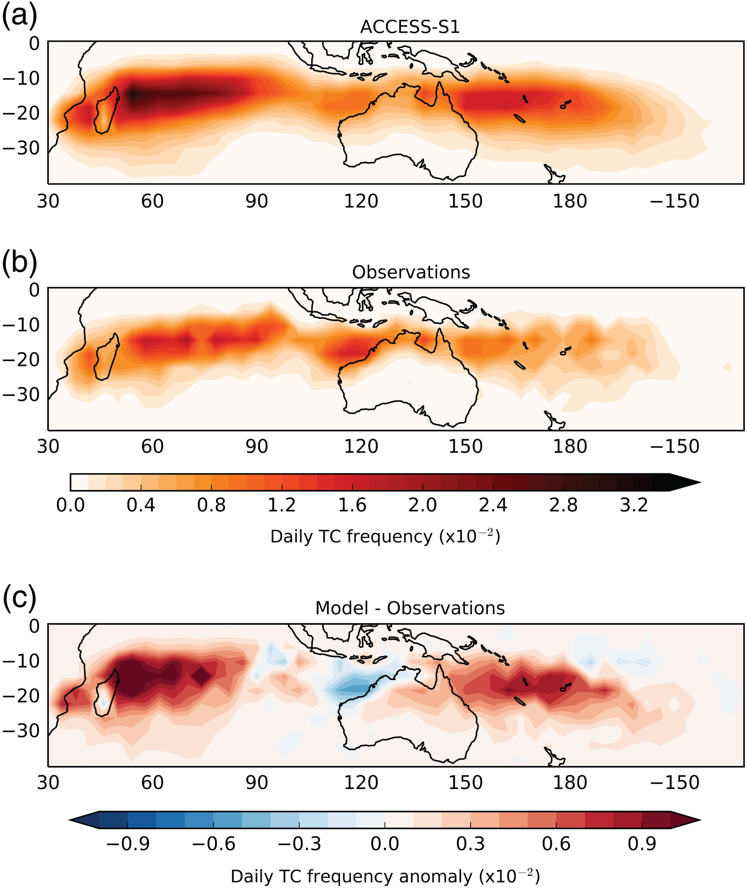
ACCESS-S: TC climatology
NW Australia – bias likely related to the dry rainfall bias which develops in the first week of an ACCESS-S forecast, as well as a cold SST bias from month 2
The positive bias also shows up in the UKMO model in similar location as ACCESS-S indicating that the bias may be in the model (known wet-bias in the South Indian Ocean)
Daily TC track frequency for (a) ACCESS-S1, (b) observations and (c) corresponding anomalies for forecast days 4–40 starting November 1, December 1, January 1 and February 1, 1990–2012. The total number of days used for ACCESS-S1 is 37,444 (23 years × 11 members × 4 start dates × 37 days) and for that observations is 3,404 (23 years × 4 start dates × 37 days)

Slide 10
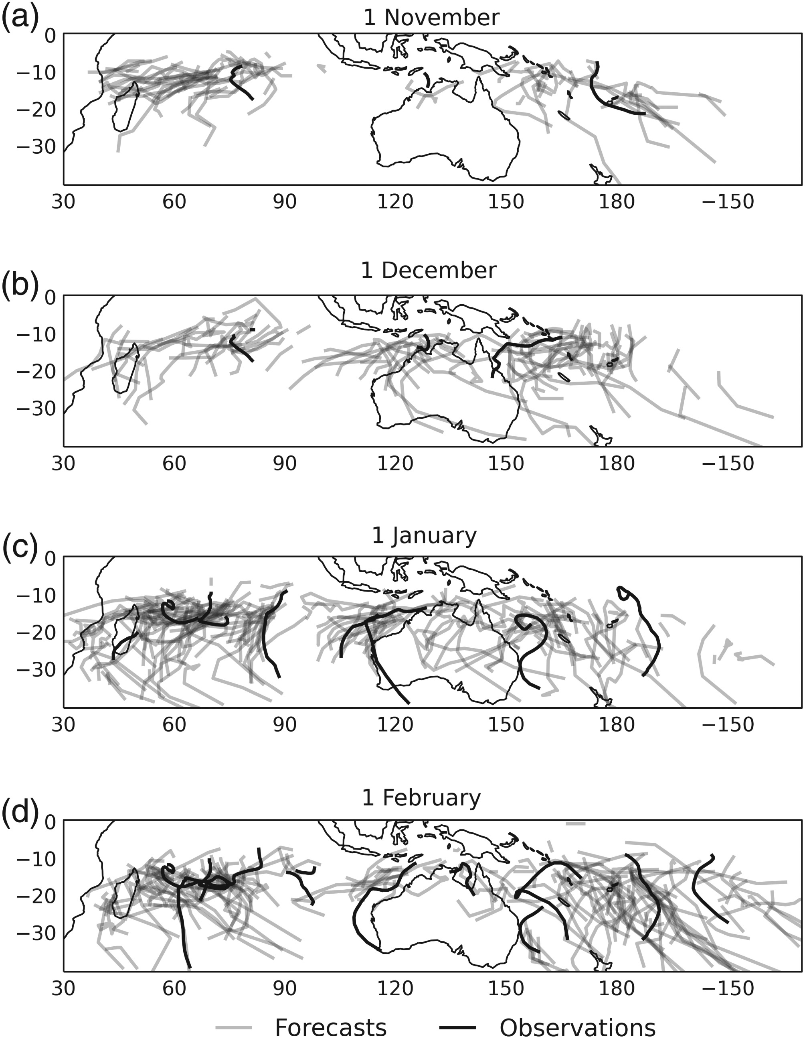
ACCESS-S V JTWC best-track 1990
Realistic representation of location and direction of tracks
ACCESS-S captures the increase in number of tracks in January and February

Slide 11
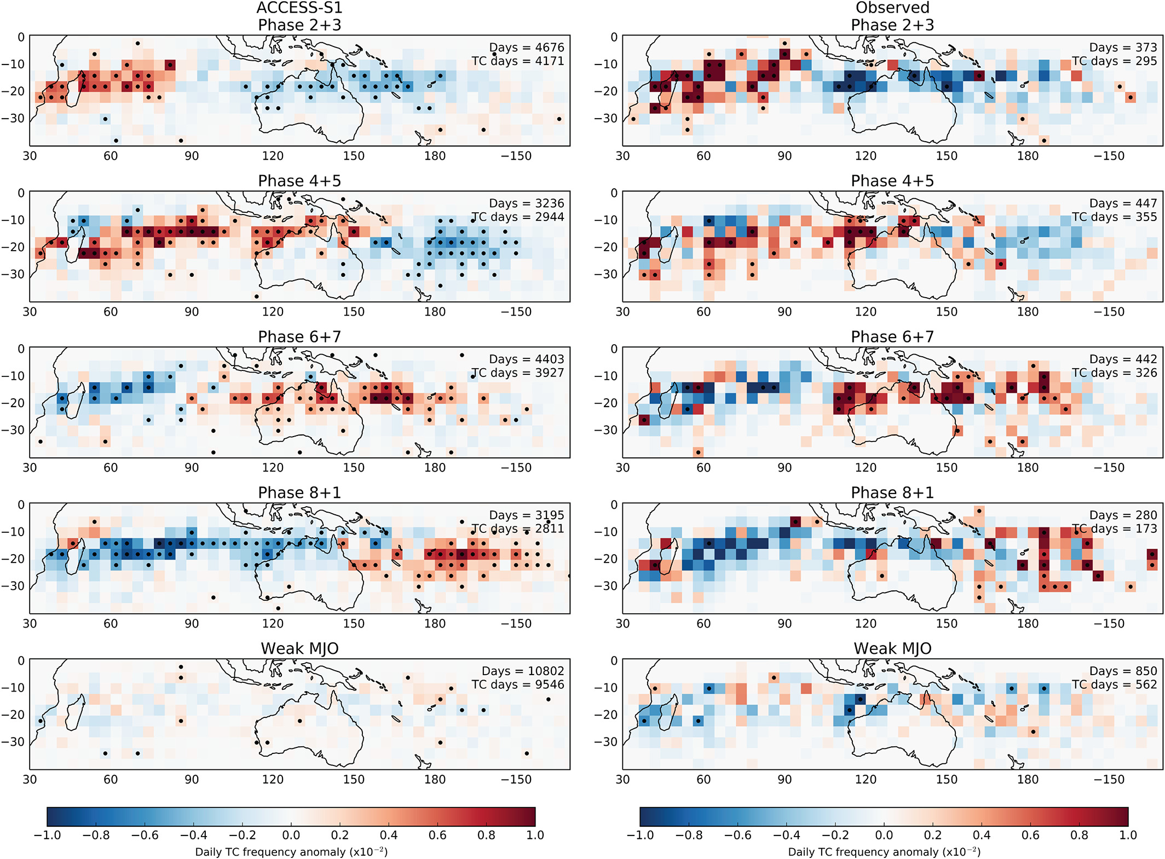
ACCESS-S V JTWC best-track 1990
ACCESS-S captures the increase in TC frequency as the MJO moves eastwards
Also capturing the suppressed TC activity before and after an enhanced MJO phase
850-hPa absolute vorticity (VORT), 600-hPa relative humidity (RH) and 850–200 hPa vertical wind shear (VWS) are well represented in ACCESS-S – this means a skillful MJO forecast
Daily TC track frequency anomalies for (top to bottom) MJO phases 2+3 (Indian Ocean), 4+5 (Maritime Continent), 6+7 (western Pacific) and 8+1 (Western Hemisphere and Africa) and when the MJO was weak (amplitude <1). Results are shown for ACCESS-S1 (left) and observations (right) for forecast days 15–40 starting on November 1, December 1, January 1 and February 1, 1990–2012. Black dots indicate where the TC track frequency anomaly is significant at the 95% level. The total number of days used for ACCESS-S1 is 26,312 (23 years × 11 members × 4 start dates × 26 days) and that for observations is 2,392 (23 years × 4 start dates × 26 days)

Slide 12
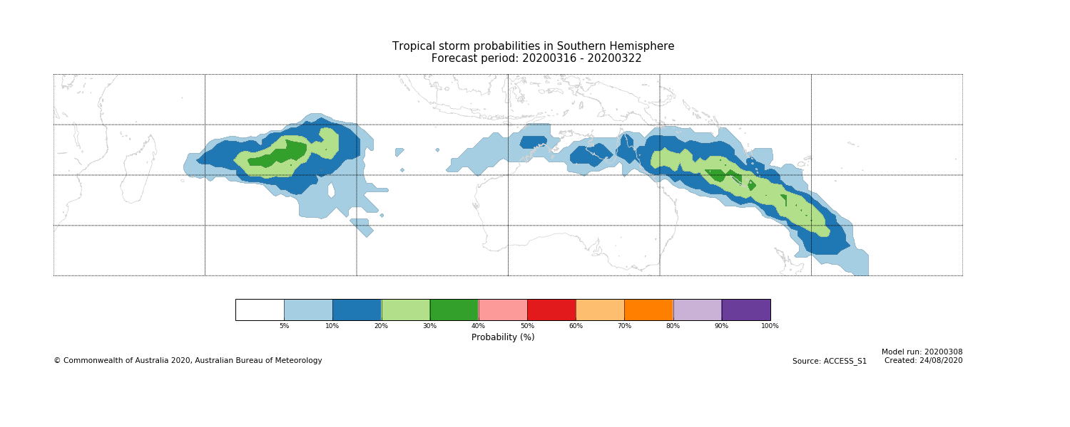
ACCESS-S: What is a TC probability
Storm probability shows the number of tracks (ensemble member) in an area divided by 33 (number of times the model is run). E.g. if 15 storms passed within 300km of each other at a given location, the strike probability at that point = 15/33 = 45%
Probabilities only includes tracks which met the threshold of 850 hPa wind-speed reaching 14 m/s
Raw model probabilities have higher skill at shorter forecast periods, weeks 1 and 2 as compared to calibrated model forecasts.

Slide 13
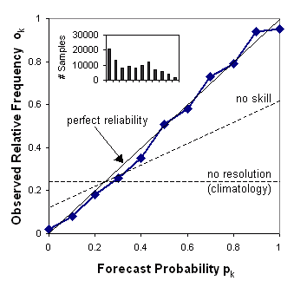
Brier Skill and Reliability: Southern Hemisphere
measuring the accuracy of probabilistic predictions
Southern Hemisphere raw model
Relative frequency with which each probability bin was forecast
The Brier score is a measure of the reliability of the model by using mean-square error of probability forecasts for a binary event, such as the occurrence/non-occurrence of a tropical cyclone.
Range: -∞ to 1, 0 indicates no skill when compared to the reference forecast. Perfect score: 1
Notes:
Reliability is indicated by the proximity of the plotted curve to the diagonal.
The deviation from the diagonal gives the conditional bias. If the curve lies below the line, this indicates overforecasting (probabilities too high); points above the line indicate underforecasting (probabilities too low).
The flatter the curve in the reliability diagram, the less resolution it has. A forecast of climatology does not discriminate at all between events and non-events, and thus has no resolution.
Points between the "no skill" line and the diagonal contribute positively to the Brier skill score. The frequency of forecasts in each probability bin (shown in the histogram) shows the sharpness of the forecast.

Slide 14
ACCESS-S calibration
OWZ tracks from ACCESS-S1 forecasts are also calibrated.
In this scheme, the forecast probabilities for each hindcast year are scaled by the ratio of the observed climate mean to the forecast mean of a TC occurrence – scaling factors
In order to verify & calibrate we need a large region, the frequency of TCs spatially is small. The size of each verification region is 15° latitude × 20° longitude (20 overlapping boxes in the southern hemisphere)… the calibration scheme degrades the spatial resolution of the forecast tracks.
The calibration scaling factors were averaged across the entire season (November–April) from 1990 to 2012.
Scaling factors are computed for each forecast lead time (i.e., days 8–14, 15–21 and 22–28) and within each verification region.
https://rmets.onlinelibrary.wiley.com/doi/10.1002/qj.3260

Slide 15
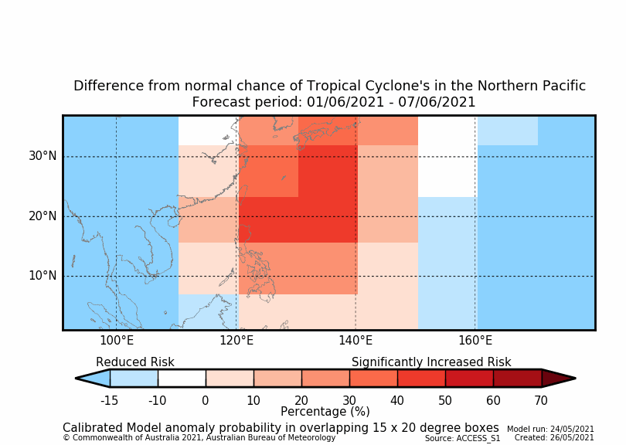
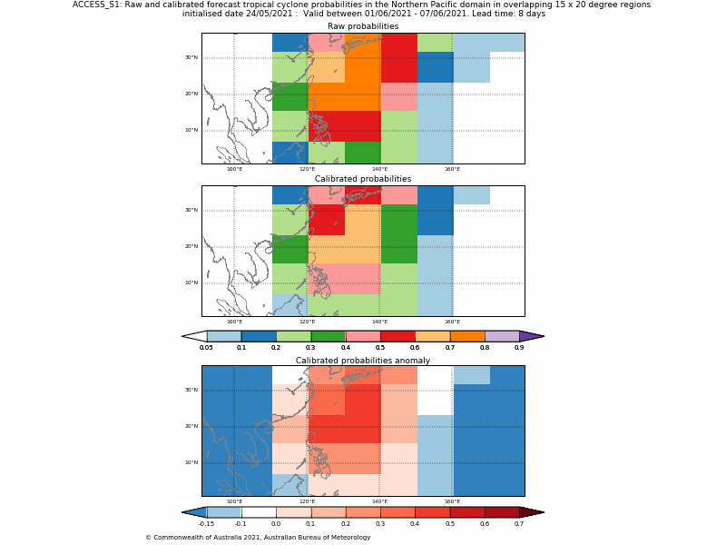
ACCESS-S calibrated forecasts
Model calibrated using the ACCESS-S1 hindcast (1990-2012).
Available for the southern hemisphere and northwest Pacific.
Different from normal chance – anomaly – forecast that is different from the increased/decreased risk at different times of the year.
Calibrated forecasts tend to perform better later on, weeks 3 and 4 (real time verification 2017/18)
Reduces false alarms (raw model can be overconfident)
Using the calibrated probabilities gives the best improvement in skill and reliability at the expense of sharpness (i.e. we lose the ability to forecast very high probability events).
Notes:
The left panel is the plot showing how we get the anomaly, on the right is the bottom panel made simpler for the public

Slide 16
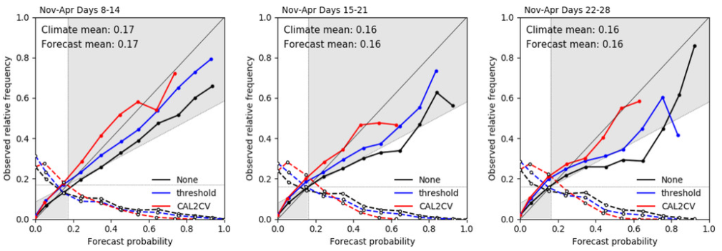
ACCESS-S1 CALIBRATED hindcast skill –
Southern Hemisphere
The hindcast is used to account for model biases
Using the calibrated probabilities gives the best improvement in skill and reliability at the expense of sharpness (i.e. we lose the ability to forecast very high probability events).

Slide 17
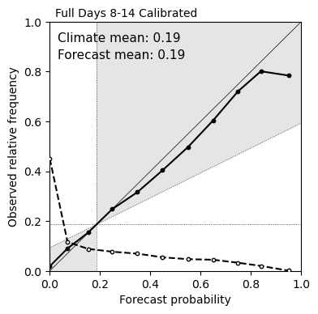
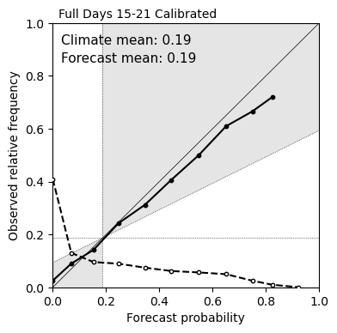
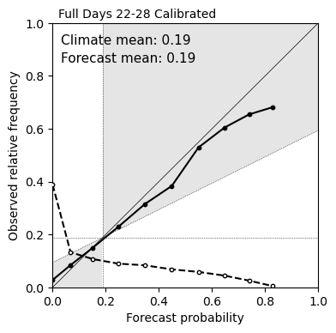
ACCESS-S1 CALIBRATED hindcast skill –
North West Pacific
North west Pacific | Days 8-14 | Days 15-21 | Days 22-28
Raw (+ 14m/s threshold) | 0.285 | 0.222 | 0.212
Calibrated | 0.310 | 0.252 | 0.235

Slide 18
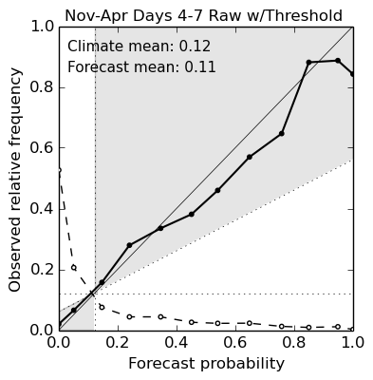
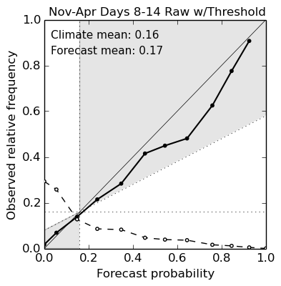
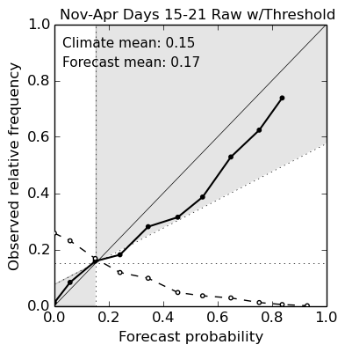
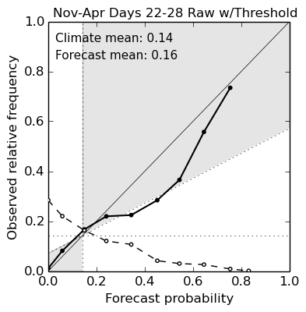
ACCESS-S1 forecast skill 2017/2018
The forecast skill for the 2017-18 season was better than the hindcast skill (SH). This could be attributed to increased number of ensembles (33 in the operational forecasts vs. 11 in the hindcast)
Use of ACCESS-G to provide the atmospheric control member in the operational forecast vs. ERA analysis in the hindcast
Strong MJO events may have increased predictability of storm formation in 2017-18 (i.e. it might have been an easy season to forecast)
Notes:
Using an 850 hPa wind-speed threshold of 14 m/s gave the best agreement with observations (i.e. higher BSS). Many of the false alarms created by the tracking scheme are removed using this threshold.
A forecast has skill if BSS is greater than zero. A perfectly reliable forecast would feature all points of the solid dotted line falling onto the diagonal (i.e. an event with a forecast probability of 40% will be observed 40% of the time).

Slide 19
How about an MME
IFS is more reliable at shorter lead times (higher resolution, more ensemble members (51), think of it as an extended NWP)
ACCESS-S1 is more reliable at longer lead times
MME is slightly more reliable at all lead times (large ensemble size: 84)

Slide 20
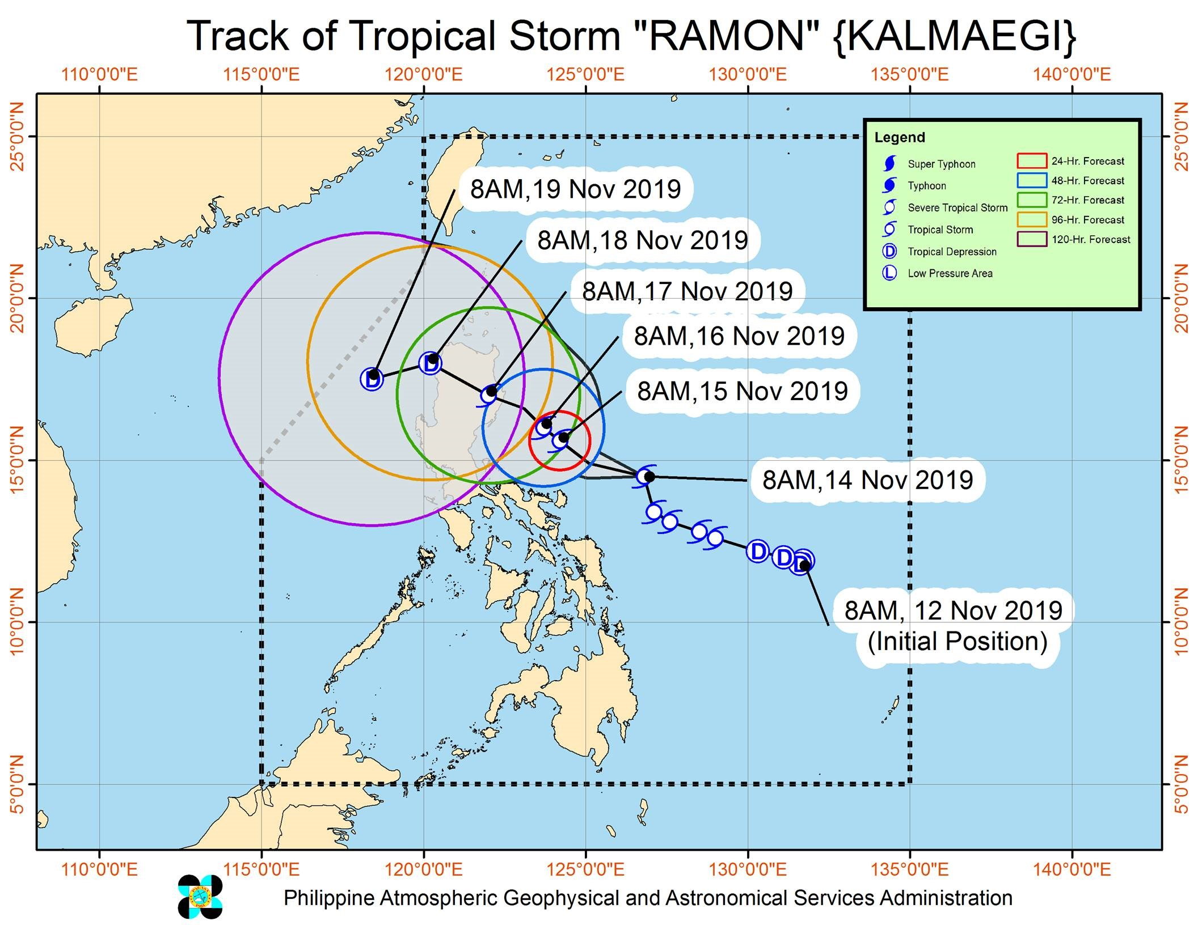
Tropical Storm Ramon (Kalmaegi) - 2019
Initialised 20 Oct 2019
Valid b/w 11-17 Nov
Initialised 21 Oct 2019
Valid b/w 12-18 Nov
Initialised 22 Oct 2019
Valid b/w 13-19 Nov
Initialised 23 Oct 2019
Valid b/w 14-20 Nov
Notes:
4 week lead time. Consistent forecast over several days increases confidence

Slide 21
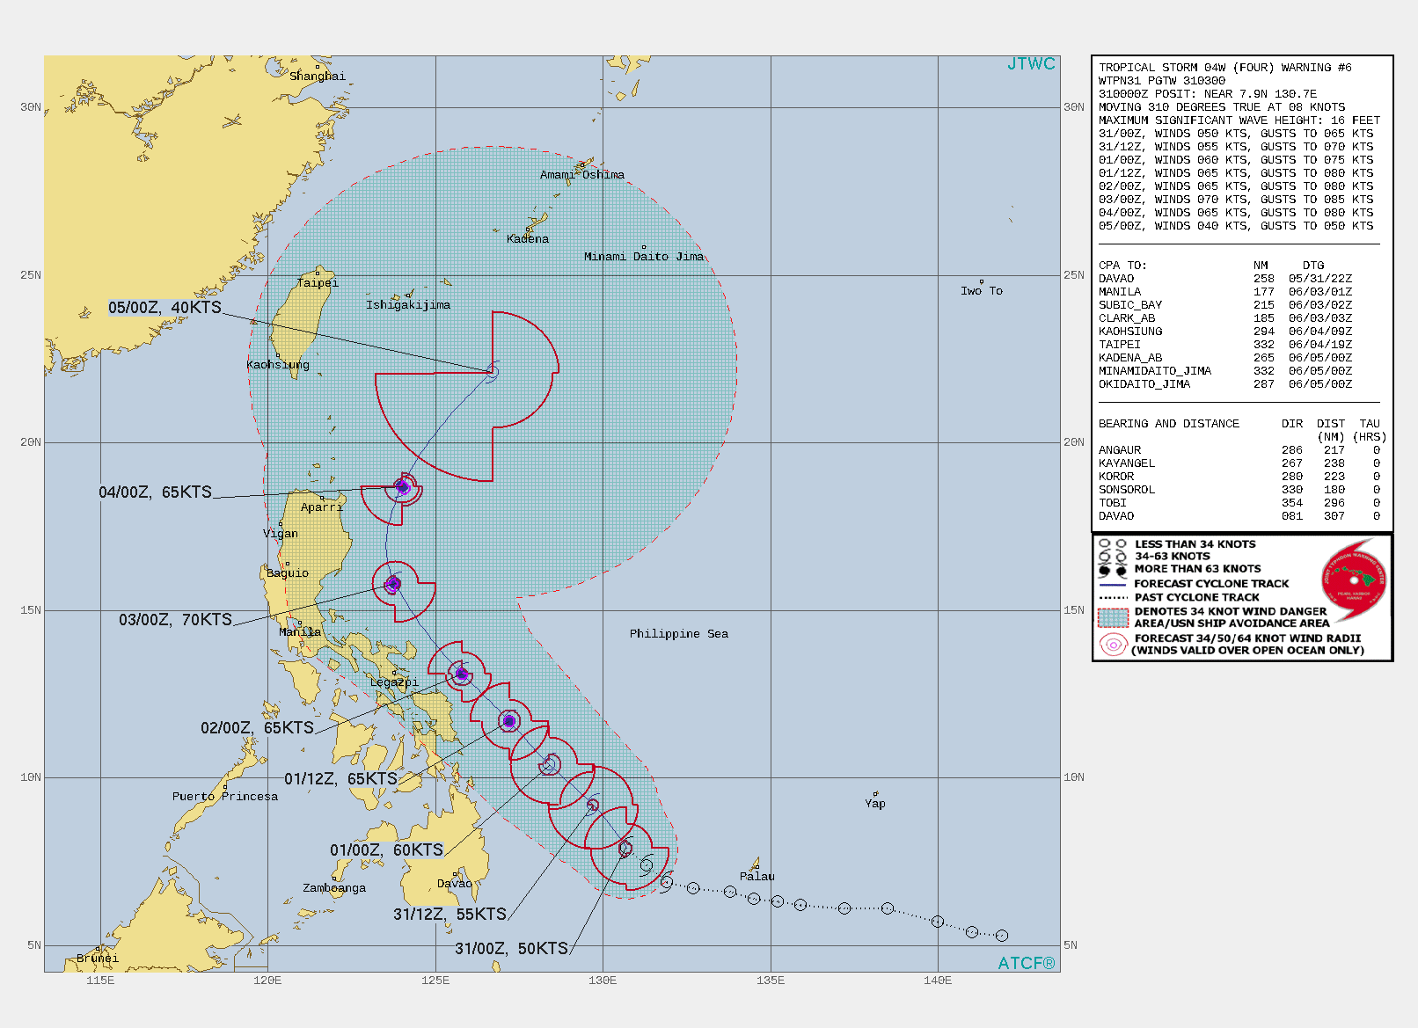
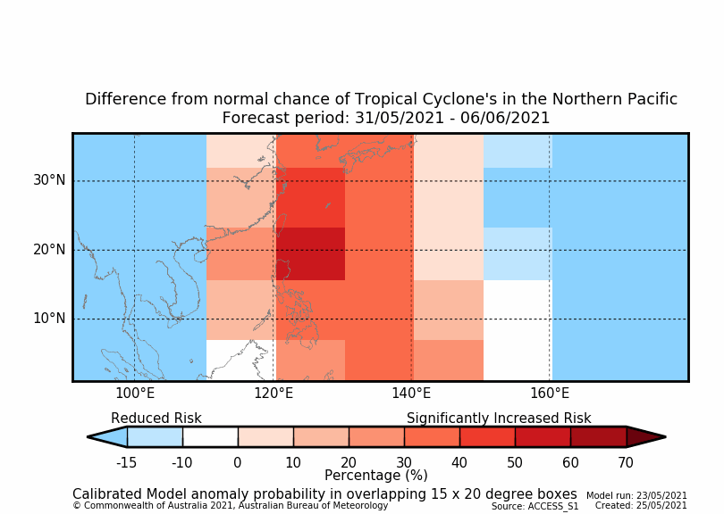
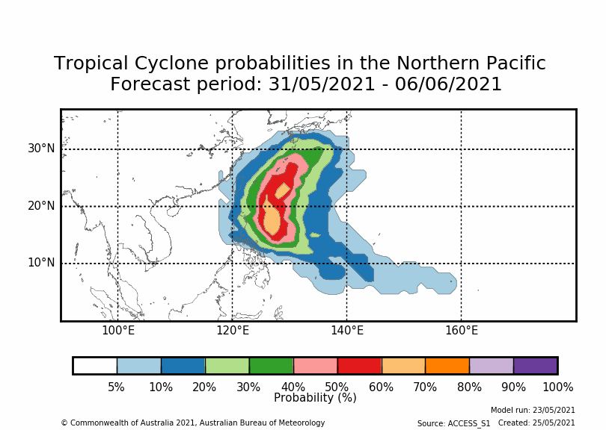
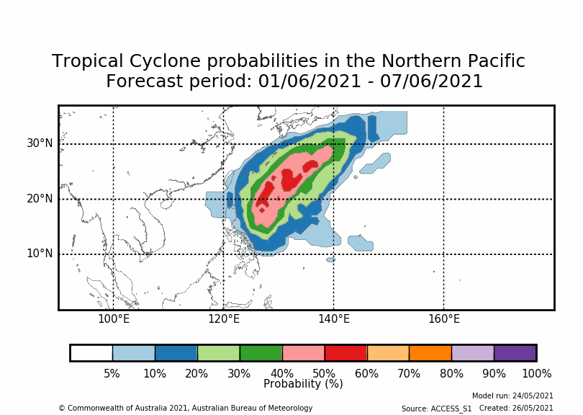
Tropical Storm Choi-wan (Dante) - 2021
Notes:
Need to replace forecast track with obs once available
Calibrated and raw probability maps. Less resolution with calibrated forecasts, however there is more confidence in higher probabilities over the 'overconfident' raw forecast

Slide 22
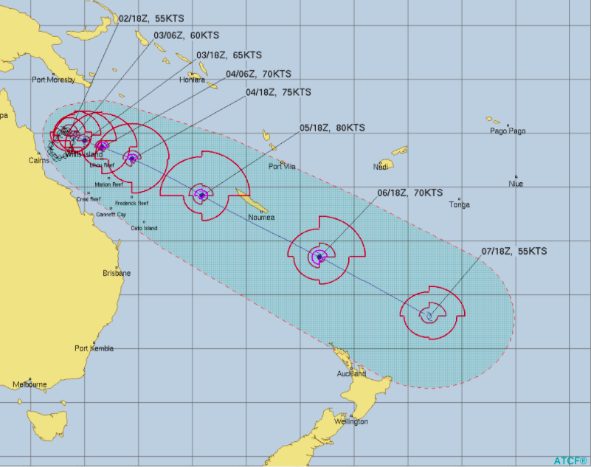
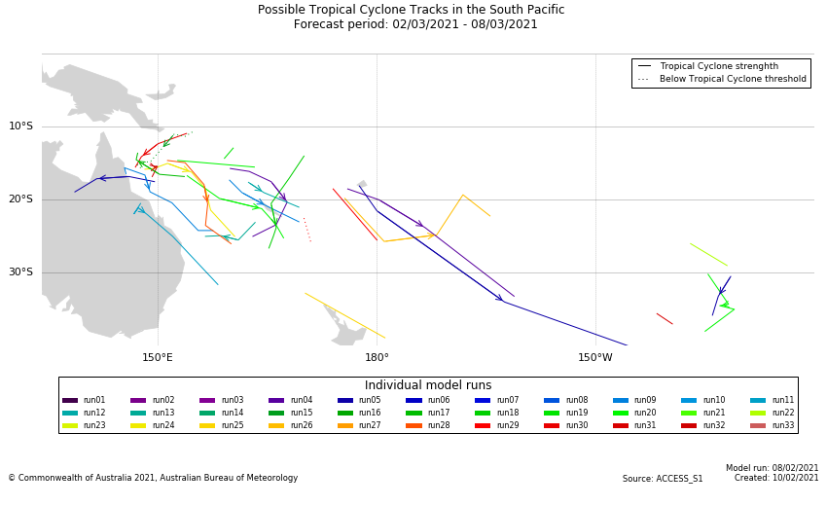
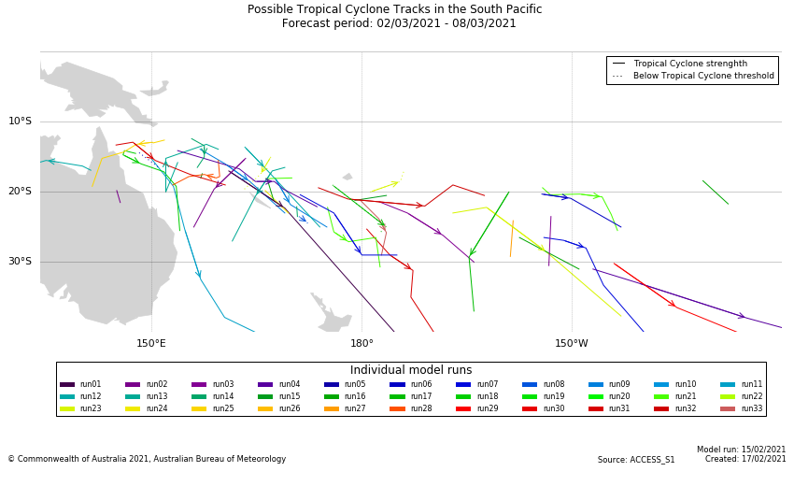
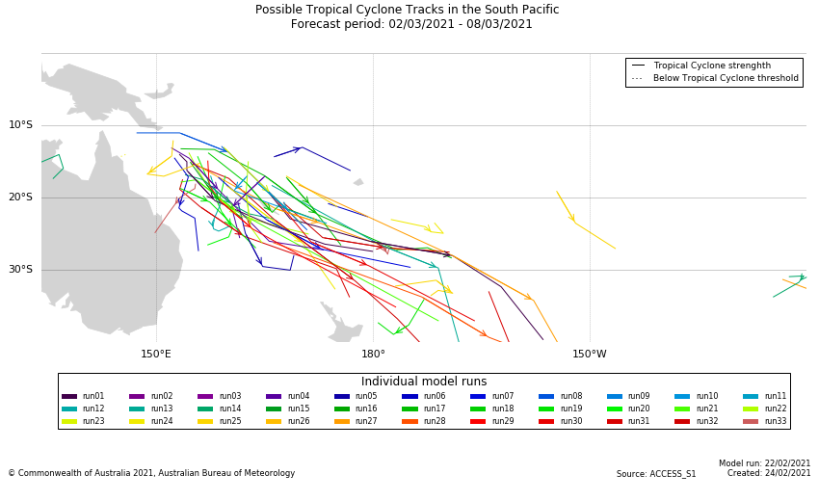
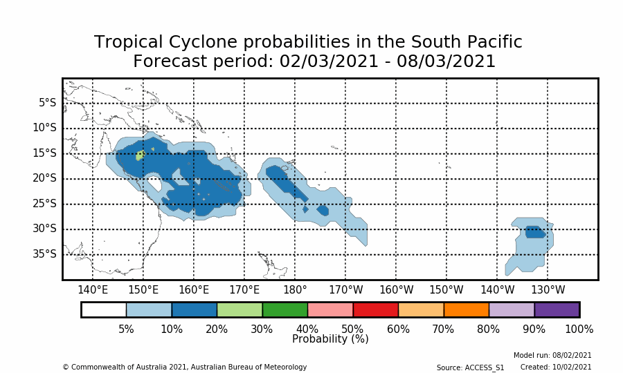
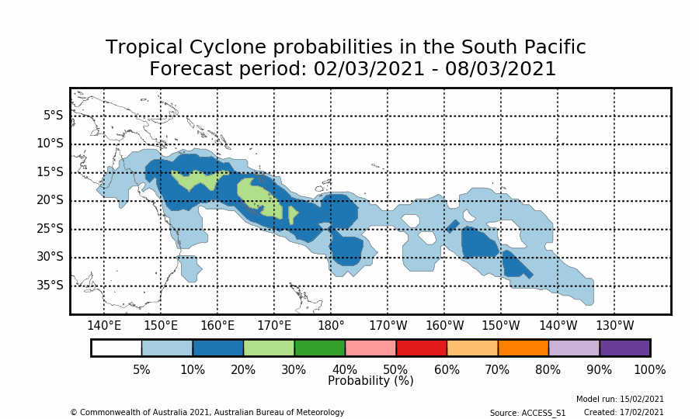
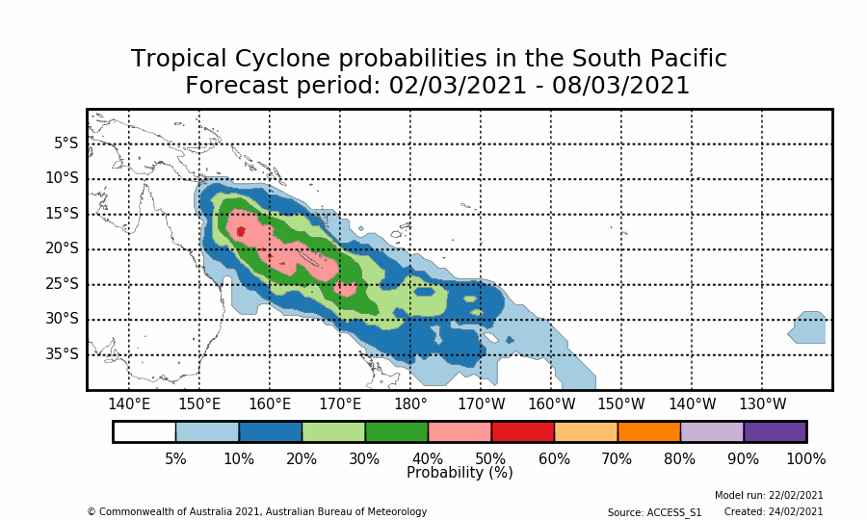
Tropical Cyclone Niran- 2021
Forecast: 4 weeks out
Forecast: 3 weeks out
Forecast: 2 weeks out
Ensemble members become consistent in location and direction with shorter lead times (note ensemble member forecasts are for demonstration purposes and not for public release)
Probabilities increase with shorter lead times, probabilities tend to be smaller in the South Pacific than the north west Pacific region

Slide 23
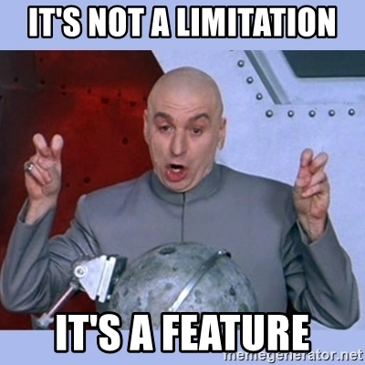
Tropical Cyclone Outlooks GOTCHA'S
A probabilistic forecast cannot predict the number of Cyclones within a particular week (or region)
It's not a daily NWP forecast nor can you add the weekly forecasts to get to a month. Don't apply any fancy maths!
Remember to always use your NWP TC forecast for the first week, it has better skill. ACCESS-S outlooks are not released to cover this first week, check when the model was run if you think you have a week 1 outlook because it will be out-of-date.
Only use older ACCESS-S outlooks to be more confident about todays forecast, that is, are the probabilities the same as yesterday's in the same region? A new forecast makes the previous one obsolete.

Slide 24
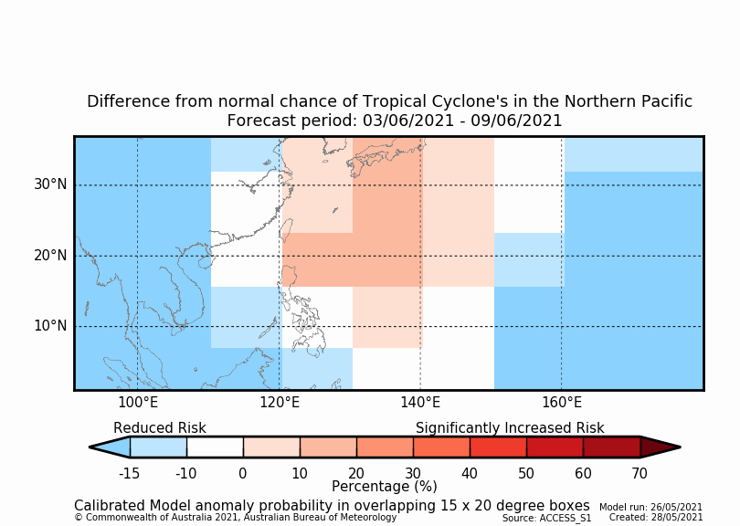
Interpretation guidance for stakeholders
Preference is to present the 'difference from normal chances' for stakeholders. This will reduce the false alarm rate.
10-30% - is an 'increased risk of tropical cyclone occurrence'
30% + - is a 'significantly increased risk of tropical cyclone occurrence'.
Remember an increased risk does not guarantee a Tropical Cyclone will form
More confidence in forecasts that show elevated risk over a number of days in a region
More confidence in forecasts at shorter lead times, e.g. week2
http://access-s.clide.cloud/files/guidance_documents/About_weekly_ACCESS-S_TC_forecasts_brief.pdf

Slide 25
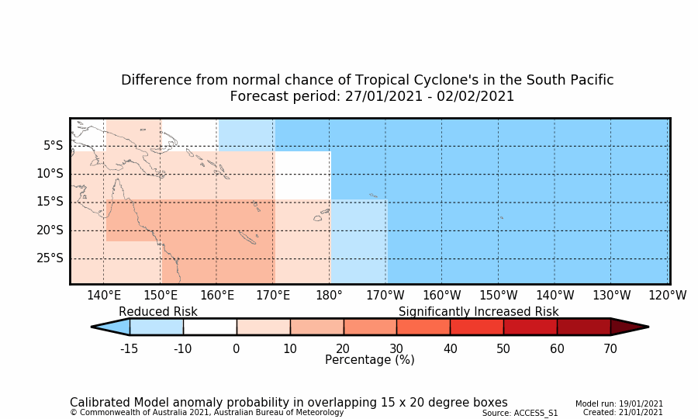
Scenario: 21st January 2021
It's January 21 and you see the below TC forecast. What do you do?
There is significantly increased risk of TC occurrence in the western South Pacific.
Have a look at the TC probability map and yesterday's forecast (are the forecasts consistent?)
Evaluate the background climate, do observations suggest a TC risk?
What do the other climate outlooks show, are they consistent with TC occurrence risk
What could be the impacts?

Slide 26
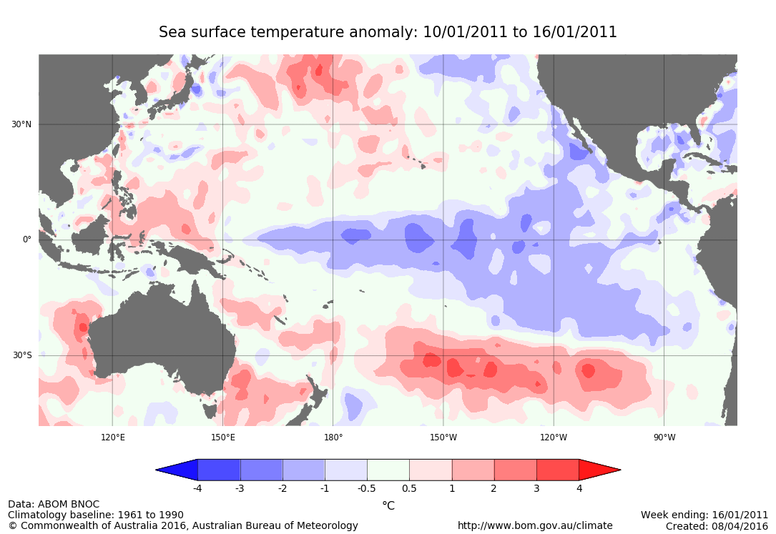
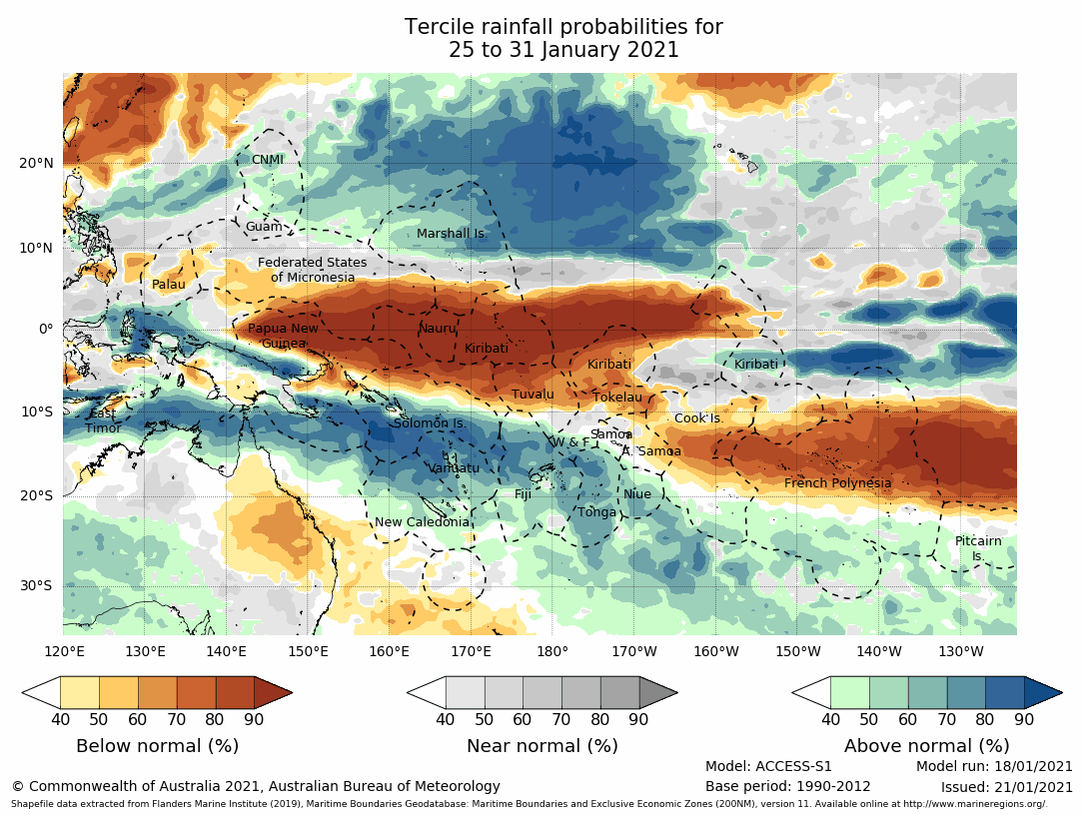
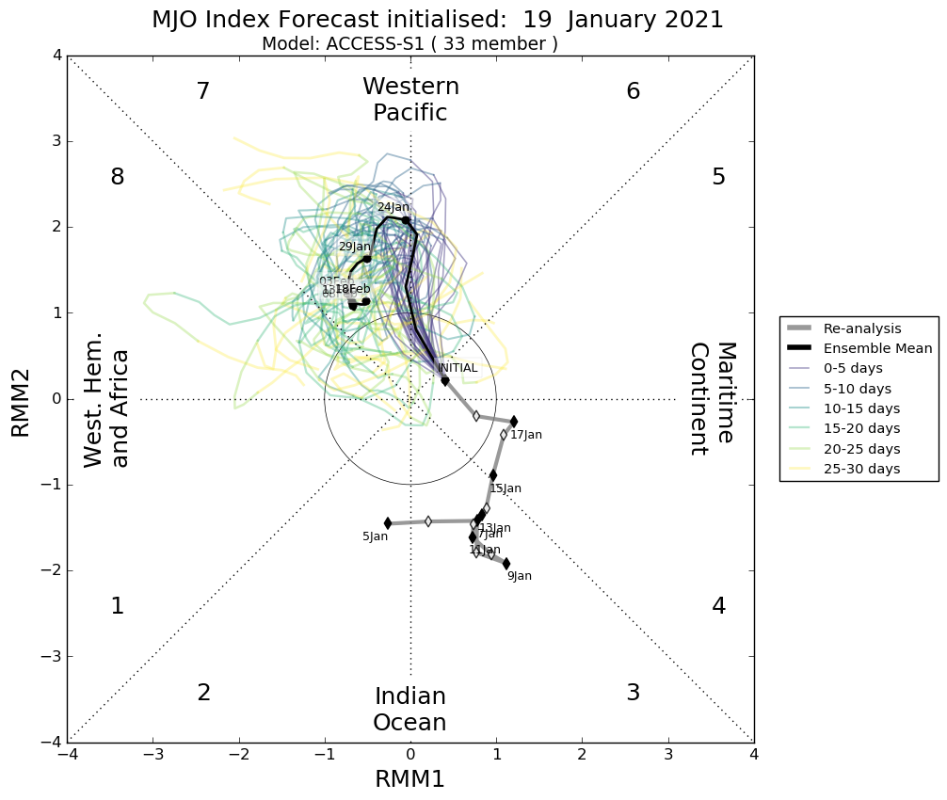
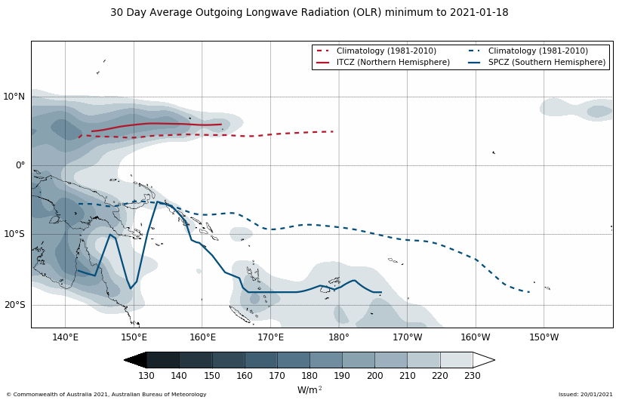
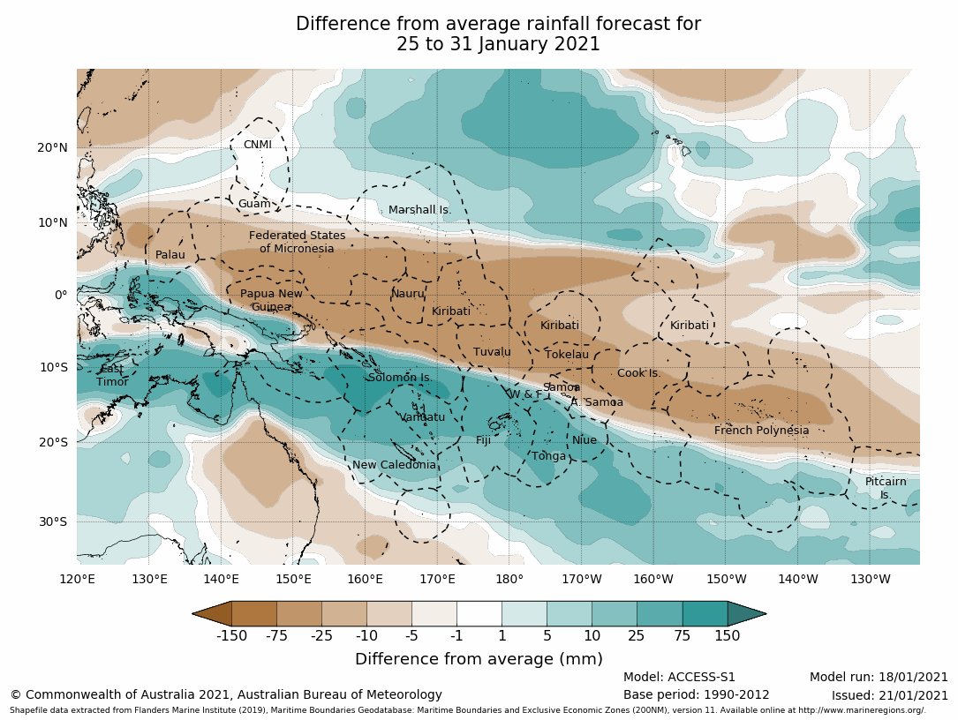
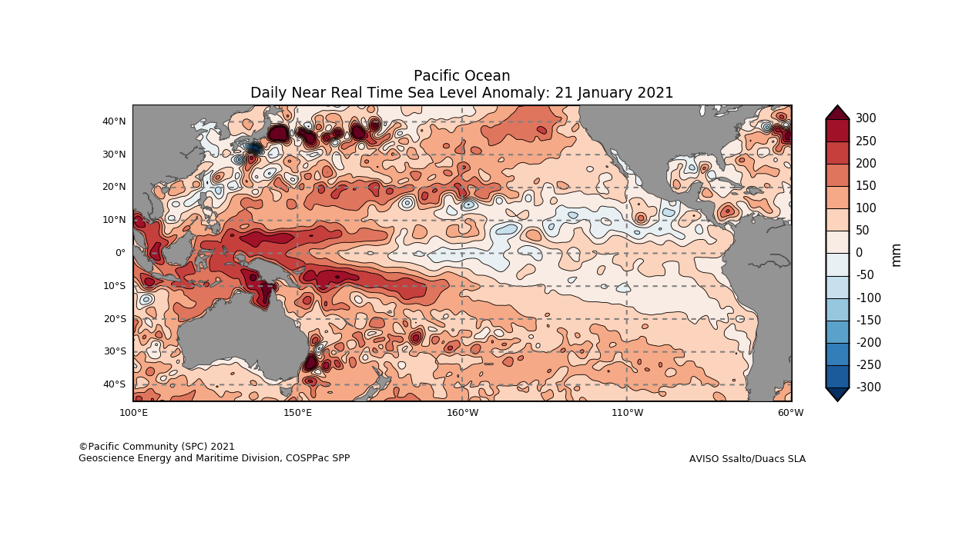
Scenario: 21st January 2021
Observations
Forecasts
Impact risks to consider:
Has there been more rainfall than usual in the last few weeks?
Are water storages already full?
Is there a risk of river or tidal flooding?
Climate forecasts available: Week 2 (25 – 31 January 2021)

Slide 27
February 1 2021

Slide 28
Conclusion
Consider both probability and calibrated anomaly probability forecasts
Monitor forecasts from previous days, confidence increases with persistence over time
The model is in general overconfident, particularly in the South Pacific, it predicts more Tropical Cyclones than are observed.
The false alarms can be improved by calibrating the forecasts (difference from normal outlooks), however we lose the ability to forecast very high probability events.
Tropical Cyclone outlook skill is highest in Week 2 (and week1) of the forecast period
Calibrated anomaly outlooks offer some skill in Weeks 3 and 4
Use consistent terminology with stakeholders and see the guidance documentation for more information.
Consider other aspects of the climate system and the forecasts, are the impacts from a cyclone particularly high, such as, is river flooding more likely due to catchments already being wet?

