Slide 1
Drought monitoring
Basic concepts and recent changes to EAR Watch methodologies

Slide 2
What is drought?
Bureau of Meteorology Drought Knowledge Centre
Understanding Drought
(https://www.youtube.com/watch?v=oXG5SaZCVNU)

Slide 3
What is the EAR Watch?
Basic rainfall monitoring and prediction bulletin
Easy to interpret
Quick to produce, content easy to obtain, low demand on staff time, more likely to be issued
For disaster management sector but can be used my other sectors within DM management committee
Only considers rainfall variability BUT remember drought is a complex phenomena
Other meteorological parameters such temperature, wind etc. (observations limited)
Stream flow, dam levels, agricultural yield etc. (not easy to obtain in the Pacific)
Socio-economic factors
EAR Watch information an indicator only, need to consider other factors (if available)

Slide 4
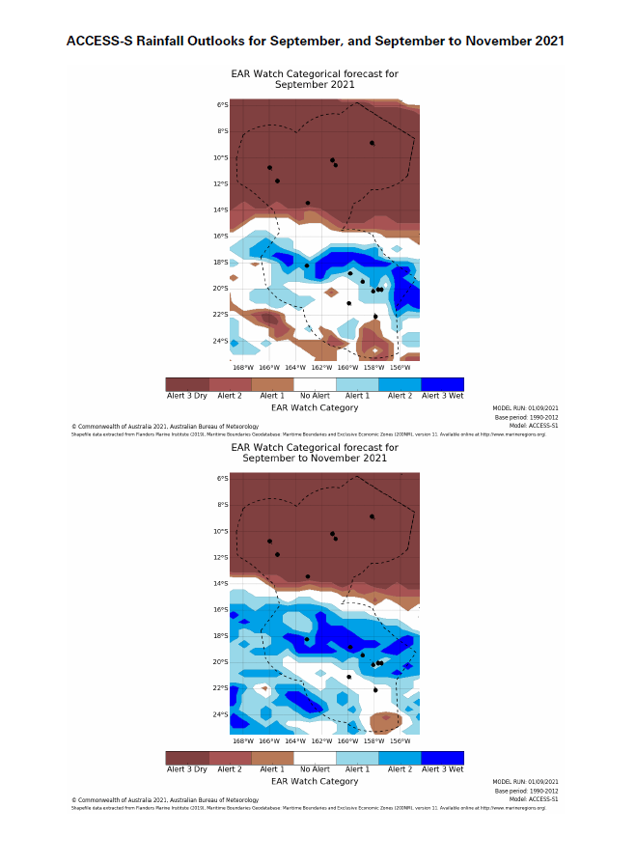
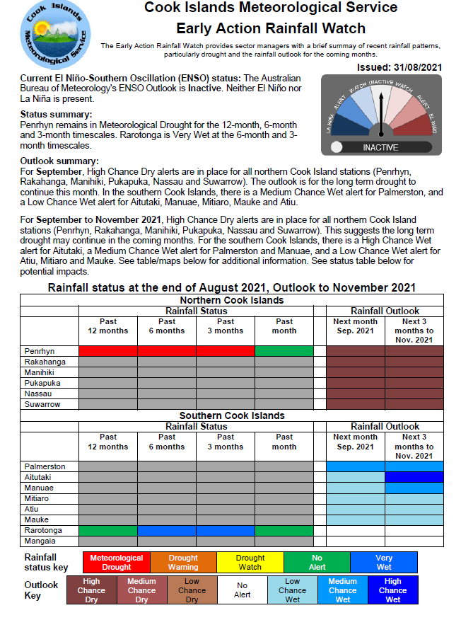
Example of an EAR Watch

Slide 5
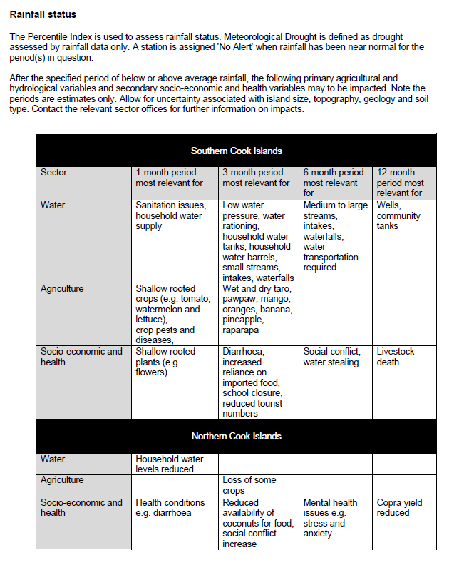
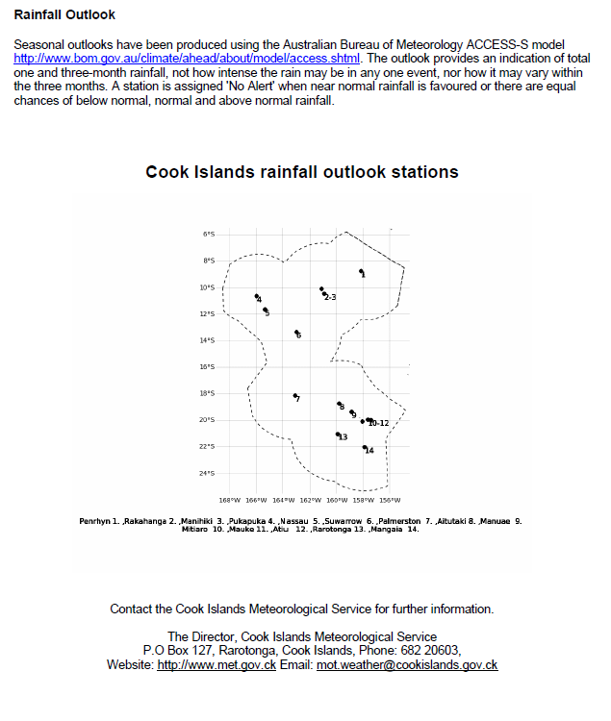
Example of an EAR Watch

Slide 6
Cases where the EAR Watch monitoring and prediction will and won't work
EAR Watch process assumes variation in the water body is largely 'controlled' by climate not by human or other environmental factors, assumes climate change impact on rainfall is small
Examples where human behaviour is dominant
Scenario 1 - The hydropower dam with rapid increase in demand
Scenario 2 - The kids go home for Christmas
Examples where climate behaviour is dominant
Scenario 3 – The irrigated farm
Scenario 4 – The rainfed taro farm

Slide 7
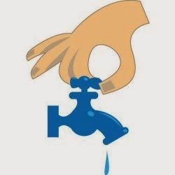
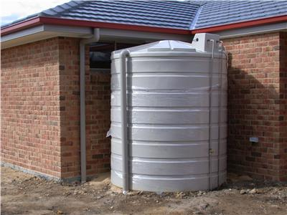
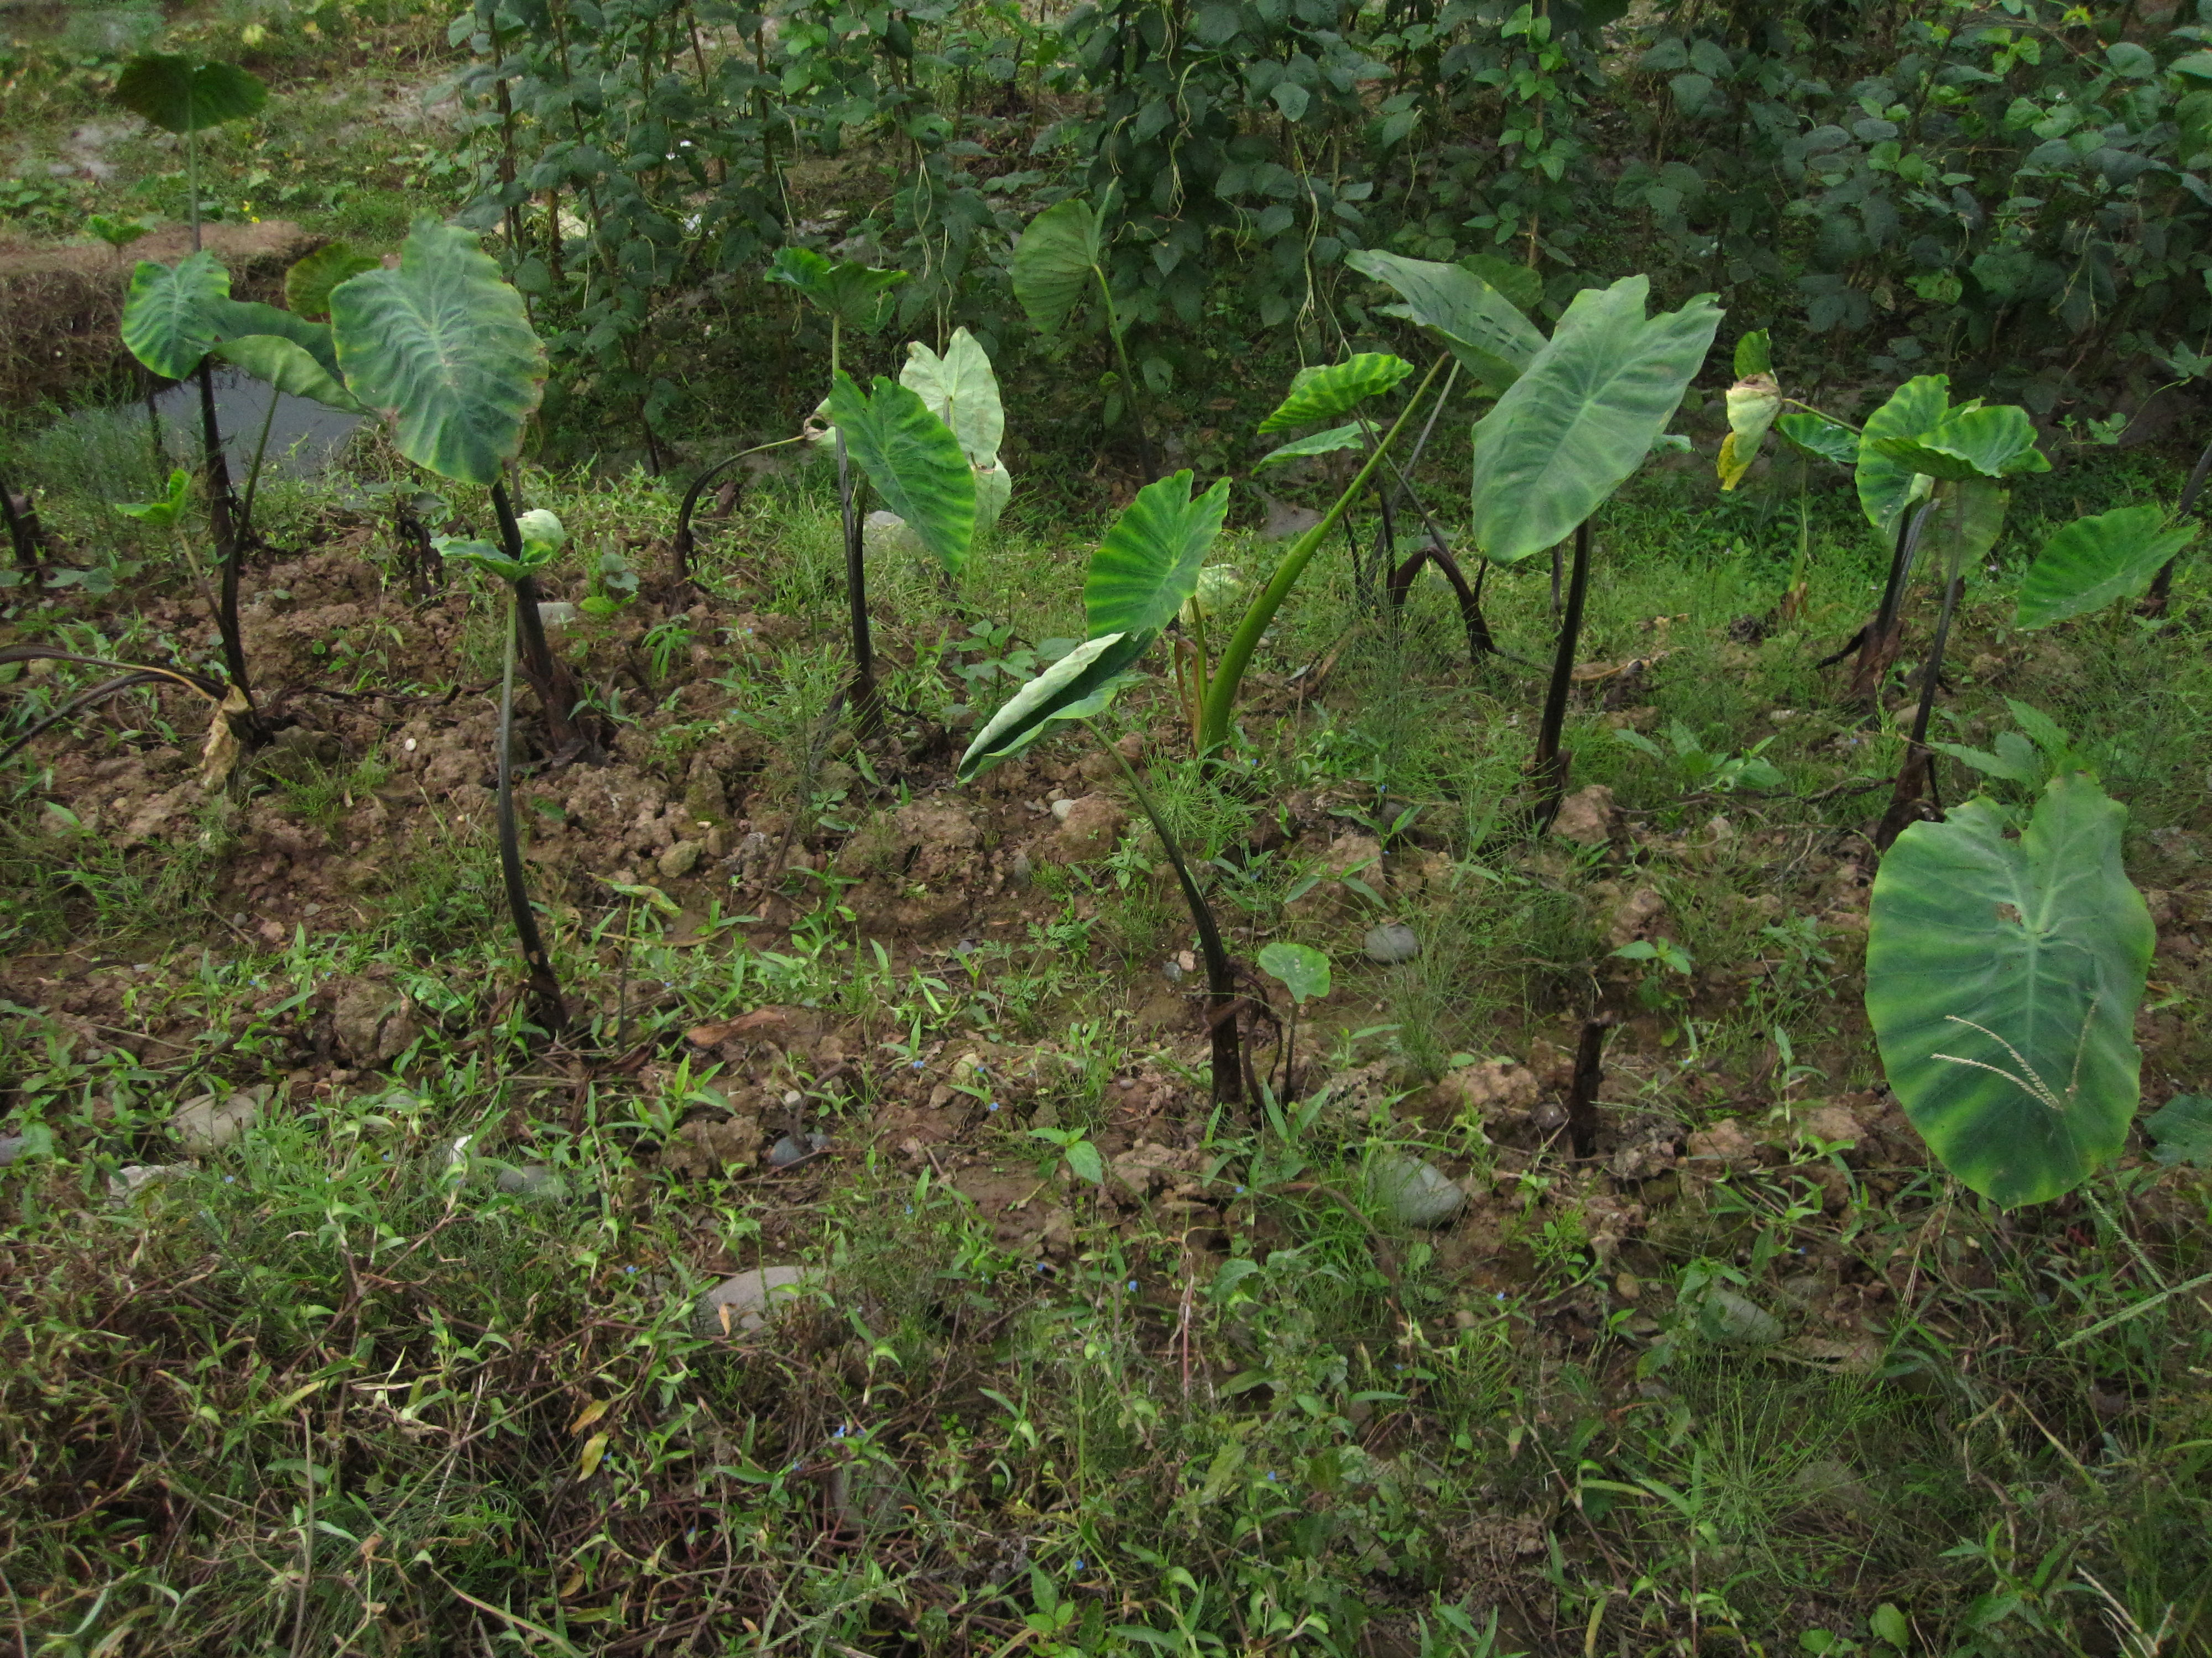
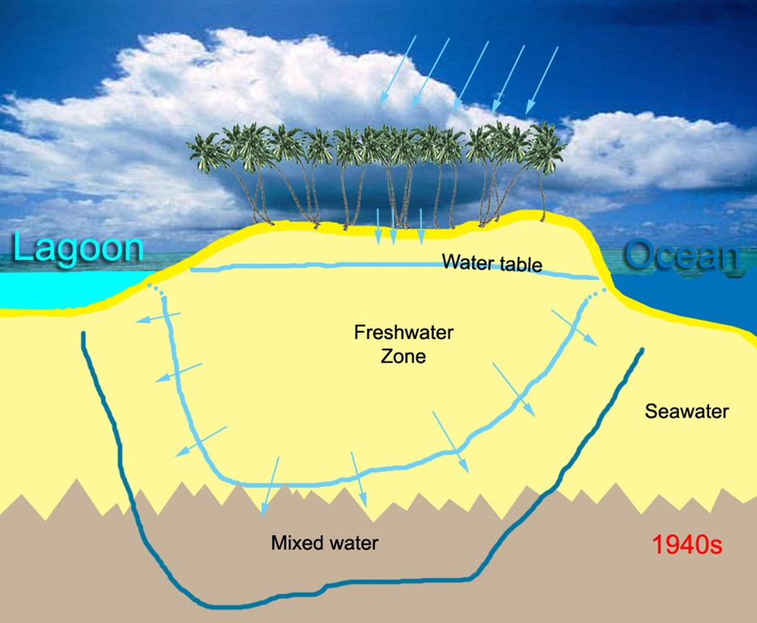
Drought timescales
Time-scales (typically 3, 6, 12, 24 or 48 months) used to represent approximate but typical periods for rainfall deficits to affect usable water sources. Can be thought of as the time required to create water stress.
<3 months
6 months
>12 months

Slide 8
Drought timescales
Drought will begin earlier for shorter timescales (shallow-rooted crops and water tanks affected first)
Larger the timescale, the larger the lag in start date (rivers and groundwater impact tends to be delayed several months)
Reverse for recovery
Drought can persist for years

Slide 9
EAR Watch drought monitoring methods
Large number of meteorological indices available. Most commonly used listed below
(highlighted ones used by COSPPac). WMO favours SPI.
Percentage of Normal Rainfall (not recommended, too simple, subject to reference period)
Rainfall Deciles (Percentile) – Drought Monitoring Tool (DMT) only
Standardised Precipitation Index (SPI) – DMT + Remote Sensing method
Cumulative precipitation anomaly
Rainfall anomaly Index (RAI)
Drought Area Index (DAI)
Palmer Drought Severity Index (PDSI) (too complex for most Pacific countries)

Slide 10
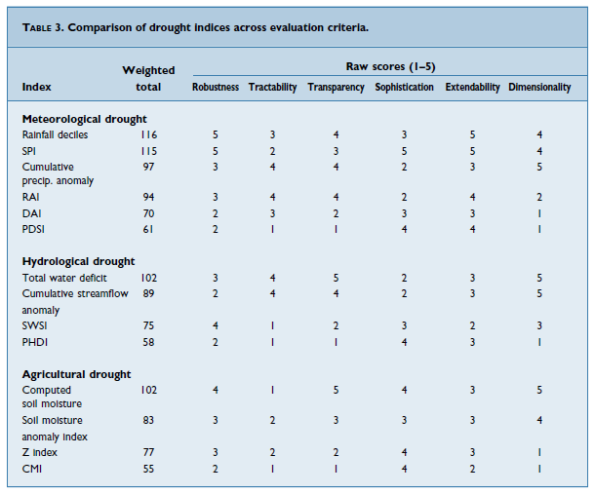
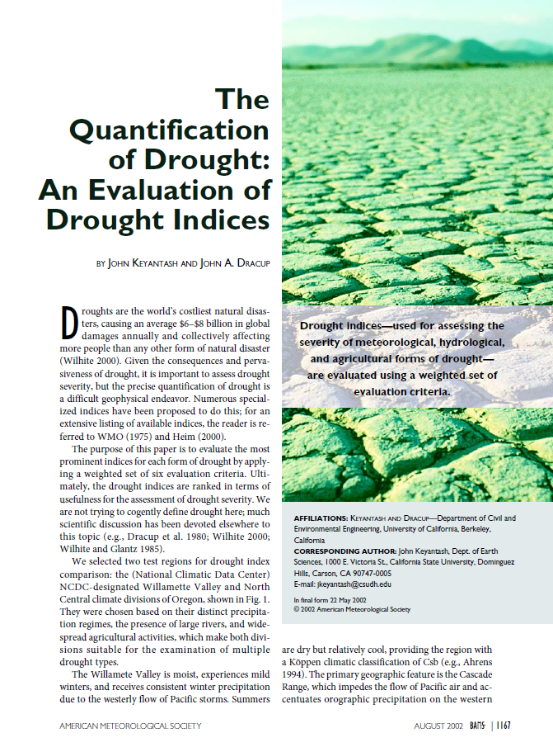
International evaluation of drought indices
(Keyantash and Dracup, 2002)

Slide 11
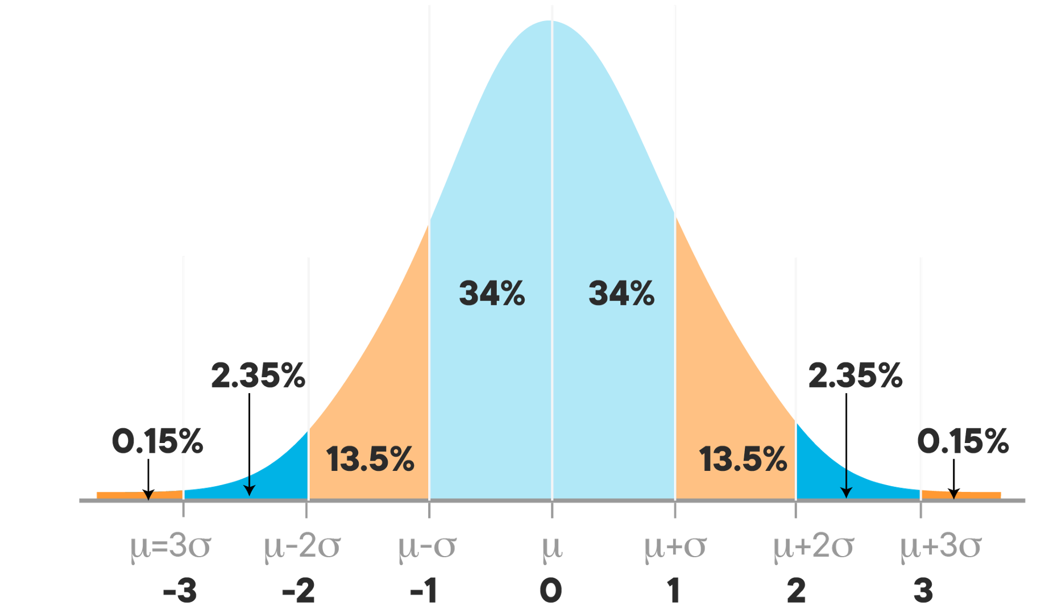
Droughts are meant to be rare events
Drought (lower 10%)
Wet Period (upper 10%)
Percentile method
Drought (lower 16%)
Wet Period (upper 16%)
Standardized Precipitation Index

Slide 12
Definitions
Meteorological drought: “declared” when the rainfall is ≤ 10th percentile (SPI ≤ ‒1)
considered to be easing when, having already been in drought, rainfall is > 25th percentile but ≤ 40th percentile (SPI > ‒0.67 but less than SPI ≤ ‒ 0.27).
drought ends when rainfall is > 40th percentile (SPI ≥ 0). Note the SPI ≥ 0 is not the equivalent of the 40th percentile. The SPI ≥ 0 based WMO guidance.

Slide 13
Definitions
Very Wet: period is applied when rainfall is ≥ 90th percentile (SPI ≥ 1)
The alert ends when rainfall is < 90th percentile (SPI < 1). This doesn't comply with WMO guidance. To be reviewed in time.

Slide 14
Definitions
Watch alert issued when the rainfall is ≤ 40th percentile (SPI ≤ ‒ 0.27)
Watch cancelled when the following criteria are met:
rainfall is > 40th percentile (SPI > ‒ 0.27) for at least three consecutive months; or
rainfall is > 50th percentile (SPI > ‒ 0.01) for one month; and
rainfall has not dropped below the next threshold (≤ 25th percentile; SPI ≤ ‒0.67) since the watch was first issued.

Slide 15
Definitions
Warning alert issued when the rainfall is ≤ 25th percentile (SPI ≤ ‒ 0.67).
Can only be applied if a Watch is current. Allowance made for the times when the rainfall drops with a month from > 40th percentile (SPI > ‒ 0.27) to ≤ 25th percentile (SPI ≤ ‒ 0.67).
Warning cancelled when the following criteria are met:
rainfall is > 25th percentile (SPI > ‒ 0.67) for three consecutive months including one month above the 30th percentile (SPI > ‒ 0.54); or
rainfall is > 40th percentile (SPI > ‒ 0.27) for one month, since the warning was first issued;
rainfall is not ≤ the 10th percentile, (SPI ≤ ‒1) since the warning was first issued.

Slide 16
Definitions
Warning alert issued when the rainfall is ≤ 25th percentile (SPI ≤ ‒ 0.67).
Can only be applied if a Watch is current. Allowance made for the times when the rainfall drops with a month from > 40th percentile (SPI > ‒ 0.27) to ≤ 25th percentile (SPI ≤ ‒ 0.67).
Warning cancelled when the following criteria are met:
rainfall is > 25th percentile (SPI > ‒ 0.67) for three consecutive months including one month above the 30th percentile (SPI > ‒ 0.54); or
rainfall is > 40th percentile (SPI > ‒ 0.27) for one month, since the warning was first issued;
rainfall is not ≤ the 10th percentile, (SPI ≤ ‒1) since the warning was first issued.

Slide 17
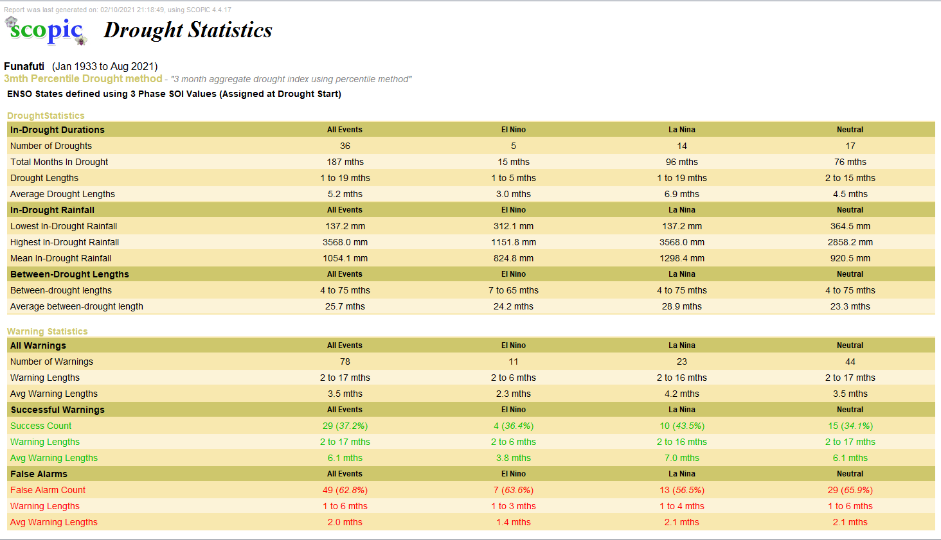
Impact of threshold adjustment (at 25%)

Slide 18
Impact of threshold adjustment (at 40%)

Slide 19
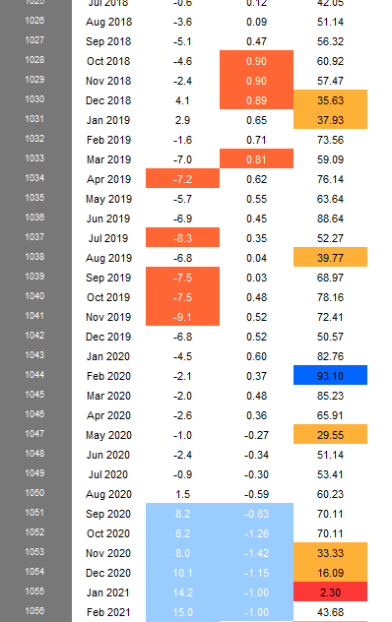
Impact of threshold adjustment (at 40%)

Slide 20
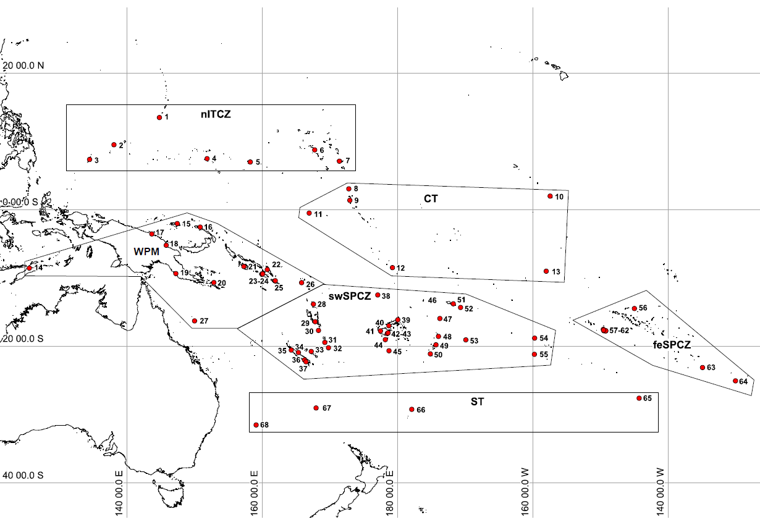
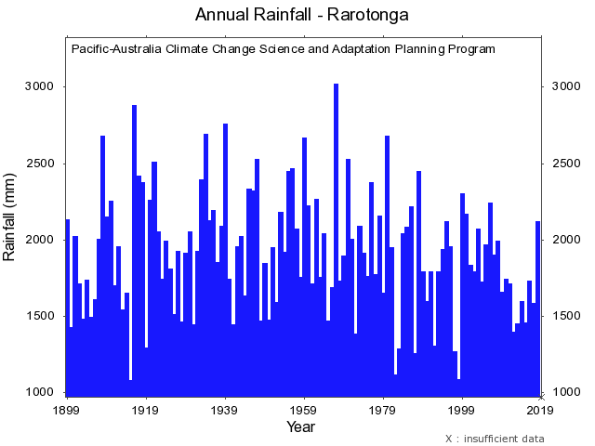
Limitations of station based monitoring
Some stations have 100+ years of data
60+ stations across the Pacific have long rainfall records but limited coverage for PNG, Cook Is., Kiribati etc.

Slide 21
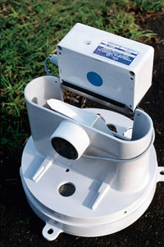
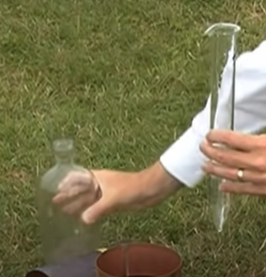
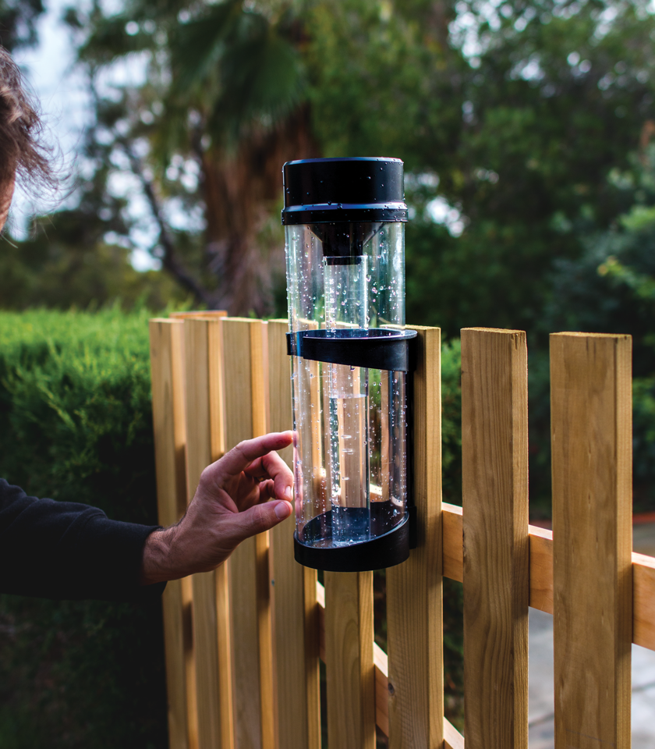
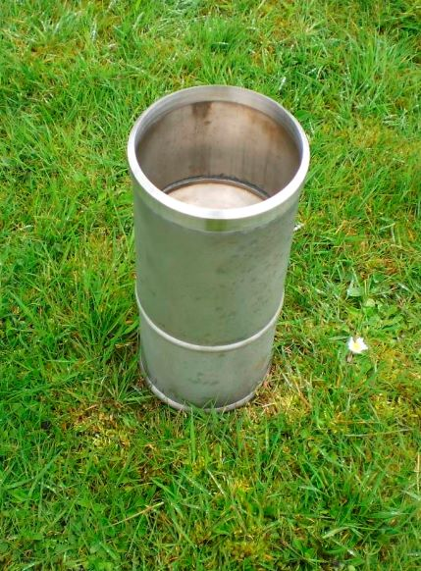
Limitations and uncertainties of station based monitoring
Correct measuring device used?
Device calibrated?
Is a meteorological standard instrument used? Appropriate height from ground?
Is there a leak?
Adequate exposure. 2x ideally 4x height of nearest obstruction

Slide 22
Thank you. Questions?

